Slide 1


Lake Erie Center
Environmental Sensor Network

Slide 2
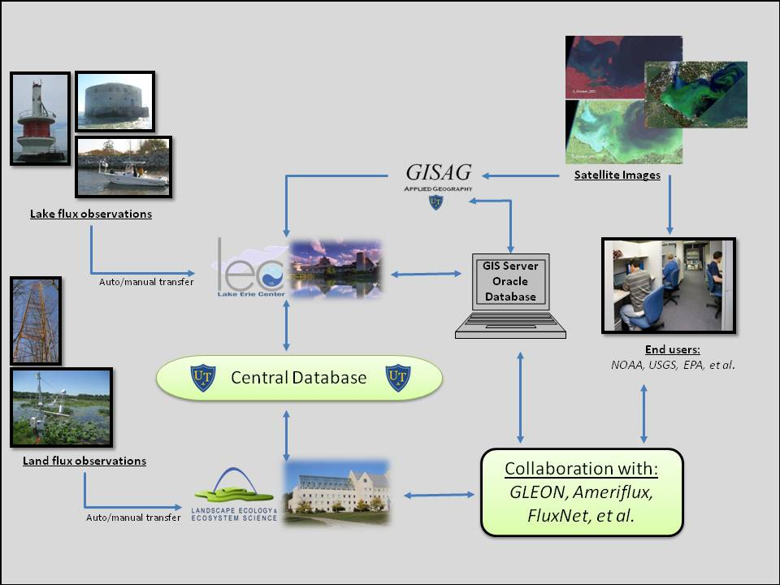
The Framework

Slide 3
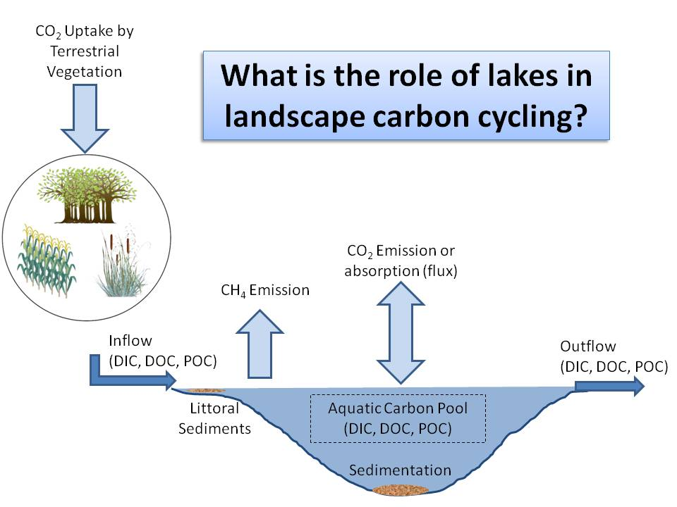

Slide 4
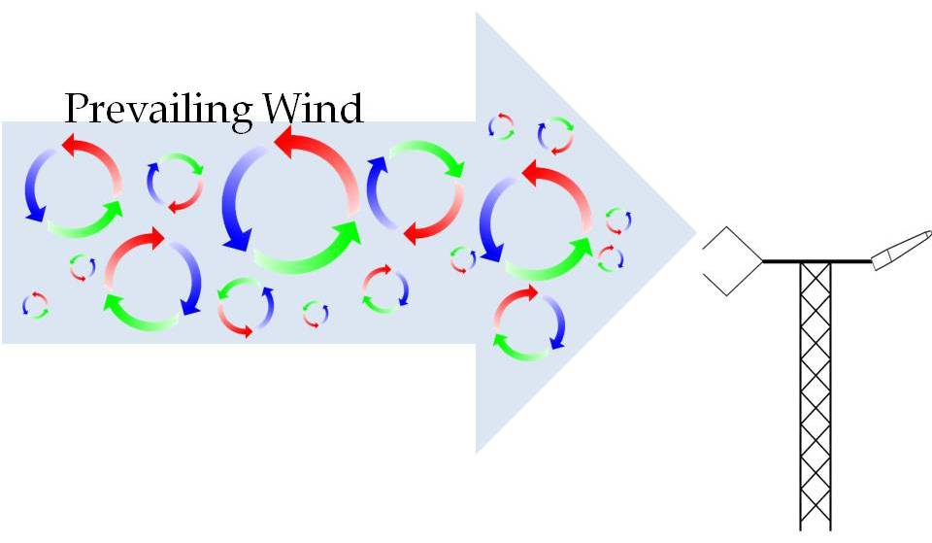
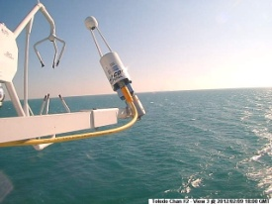
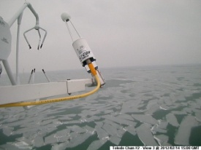
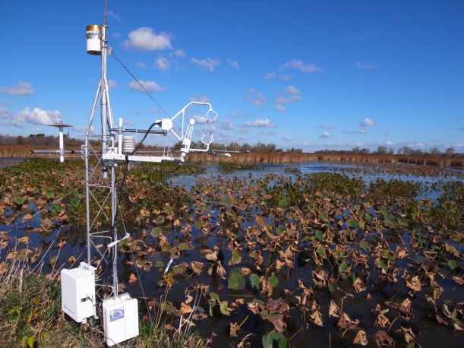
Eddy Covariance Method
Quantifies gas exchange rate as a covariance of vertical wind velocity and CO₂ concentration
Relies on a large homogenous area (footprint) for measurement
Requires state-of-the-art instrumentation with very quick response (10 hz)
Most direct and defensible way to measure ecosystem gas fluxes

Slide 5
Station Locations

Slide 6
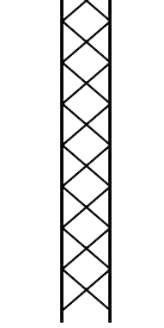
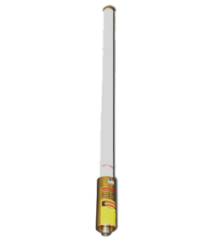

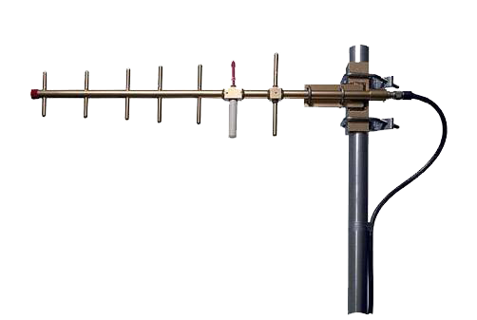


Station Telemetry

Slide 7
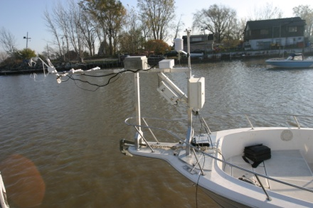
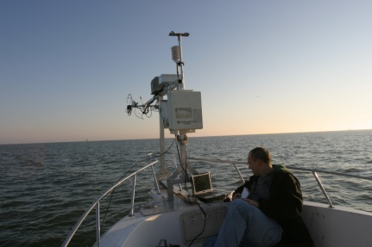
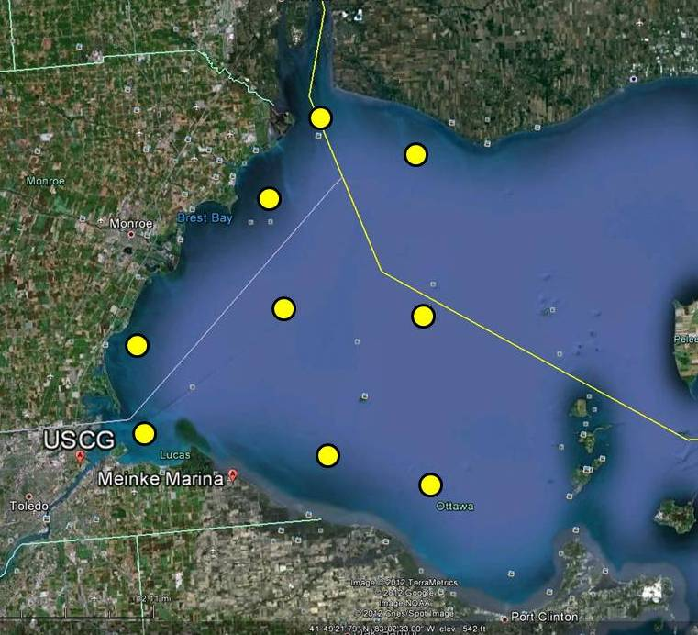
Mobile Flux Station
Mounted on the bow of the Mayflier II
Route passes through the microcystis algal bloom at the estuarine of the Maumee River
Through the sedimentary flow south of the Detroit River
Near complete depiction of spatial fluxes in the Western basin

Slide 8
Preliminary Results
PermS1 Fall 2011

Slide 9
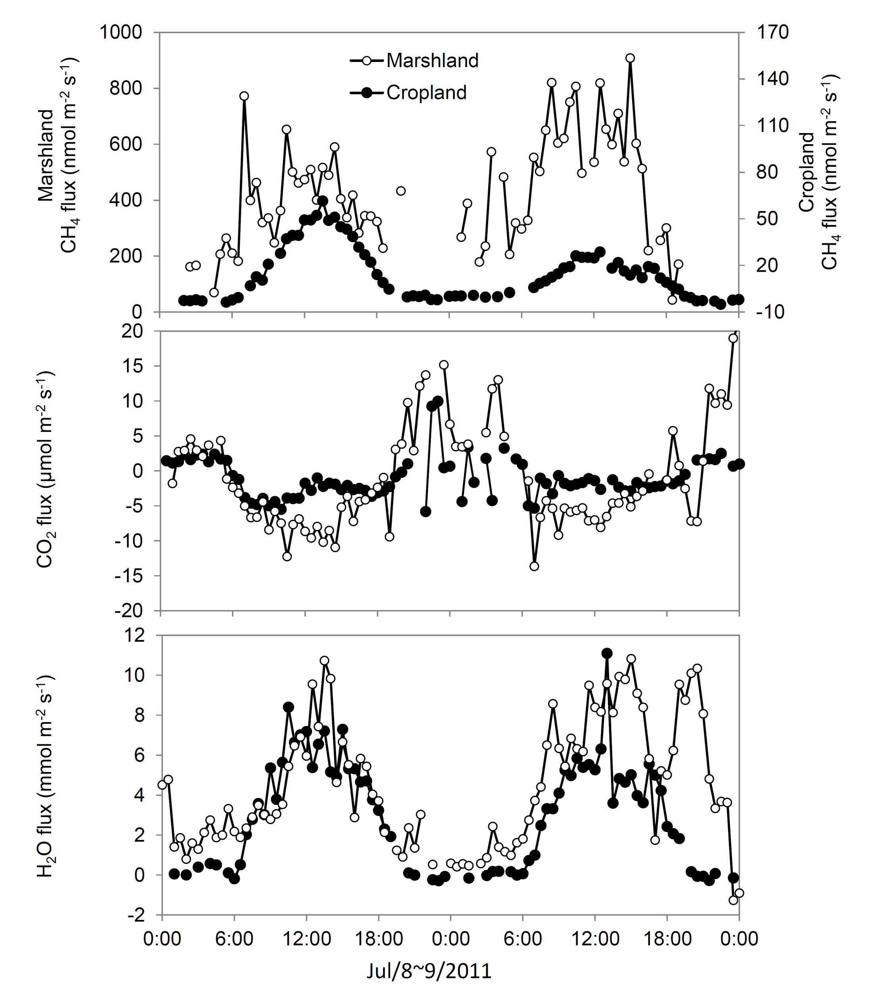
Marshland (coastal wetland) and Cropland (agricultural field) Sites
Marshland releases evident methane during the day
Cropland releases methane during the day and uptakes small amounts during the night
The orders of methane fluxes are much smaller in the cropland than in the marshland.

Slide 10
Acknowledgments
Partially funded by the FSML program of the NSF, NOAA, and USDAFS
Overseen by Jiquan Chen, Carol Stepien, Michael Deal, Johan Gottgens, Housen Chu, Richard Becker, Thomas Bridgeman, and Kevin Czajkowski at The University of Toledo

