Slide 1
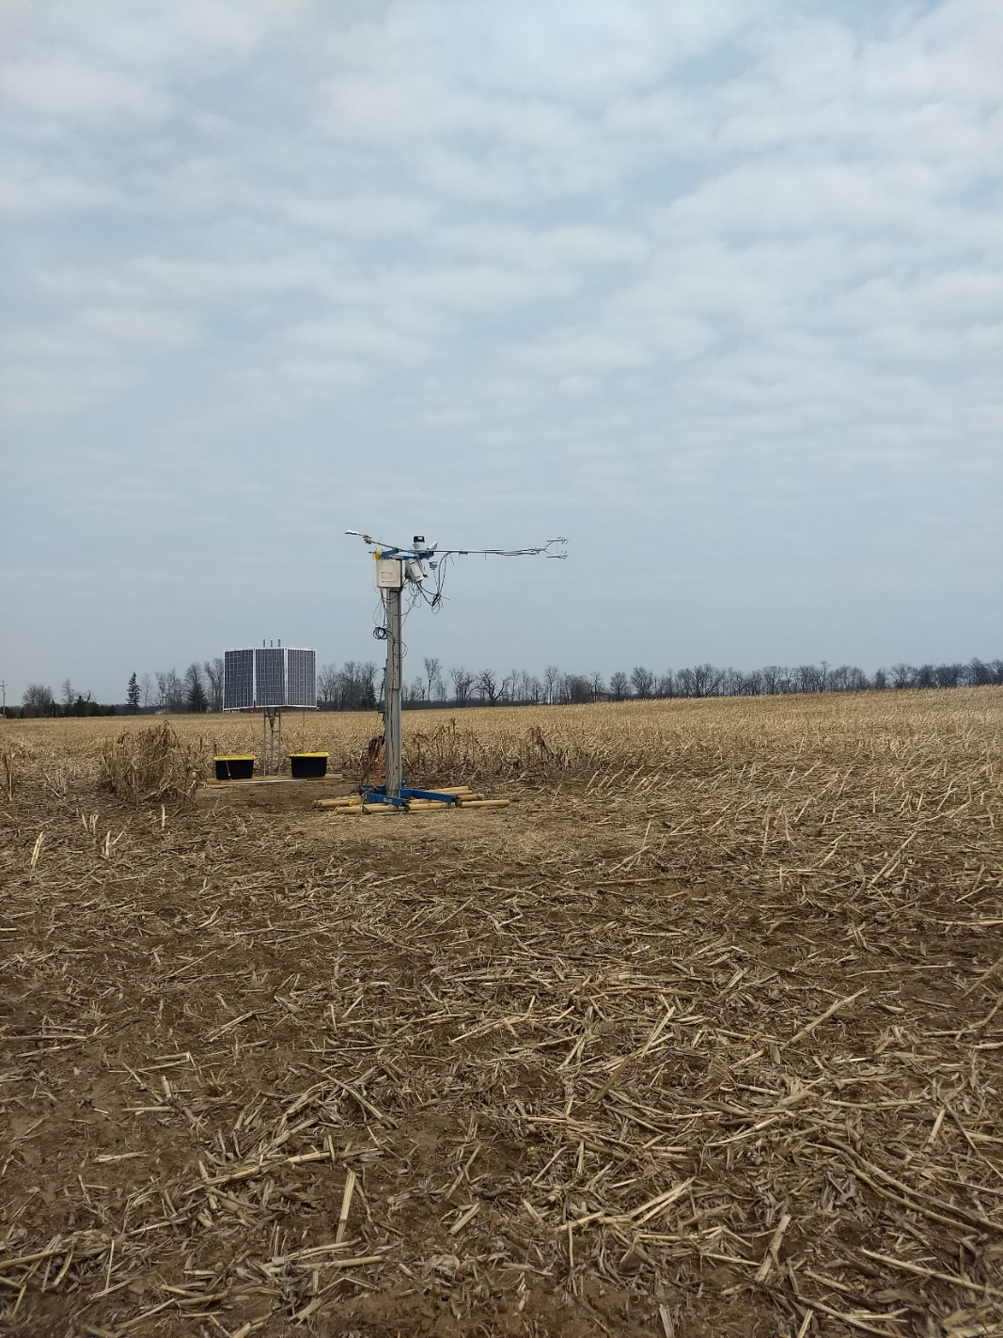
Estimating landscape level surface flux observations from a single tower

Slide 2
The postdoc upside
Besides uprooting your family and life to move across the country for a temporary position…
Working on someone else’s data, which is hopefully already collected
You’re bringing your own ideas and questions to the table

Slide 3
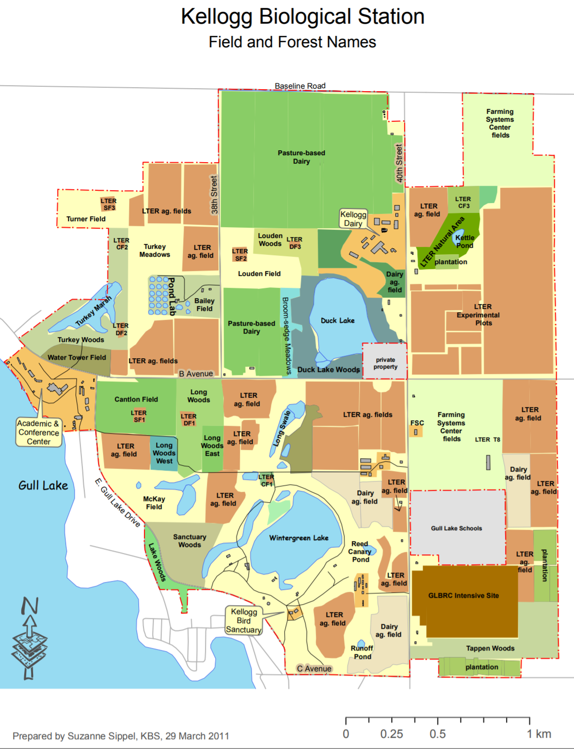
Someone else’s data
W.K. Kellogg Biological Station, Michigan State University's Long Term Ecological Research Site

Slide 4
Someone else’s data
W.K. Kellogg Biological Station, Michigan State University's Long Term Ecological Research Site
Corn
Switchgrass
Prairie
Switchgrass
Reference Grassland
Prairie
Corn

Slide 5
Someone else’s data
Landscape Ecology and Ecosystem Science lab group at MSU

Slide 6
Thought experiment

Slide 7
Annual processes

Slide 8
Diel processes

Slide 9
Hypothetical 2nd measurement

Slide 10
Matching signals

Slide 11
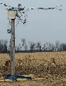
Still matching?

Slide 12
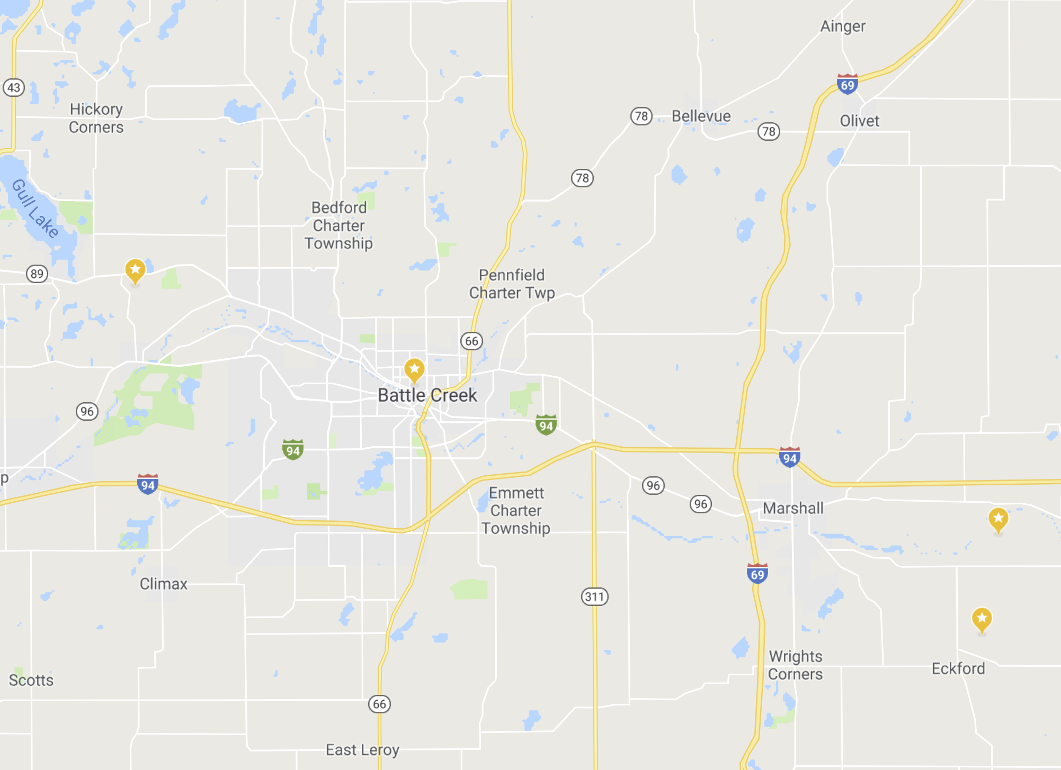
Still matching?

Slide 13
Several questions
Is there a relationship between signal coherence of paired sites and distance between the paired sites?
Does some distance exist where a reasonable person would believe data from one site could represent data from a second location?
Do fluxes across the Midwest have a common variability mode?
Can fluxes be estimated remotely from just environmental observations?
  At the annual timescale? Monthly?
Could information from one site be used to model fluxes from the entire landscape?

Slide 14
Several questions
Is there a relationship between signal coherence of paired sites and distance between the paired sites?
Coherence
Distance

Slide 15
Several questions
Is there a relationship between signal coherence of paired sites and distance between the paired sites?
Coherence
Distance

Slide 16
Several questions
Is there a relationship between signal coherence of paired sites and distance between the paired sites?
Coherence
Distance

Slide 17
Several questions
Is there a relationship between signal coherence of paired sites and distance between the paired sites?
Coherence
Distance

Slide 20
H/LE
GPP/Reco
NEE

Slide 21
Several questions
2. Does some distance exist where a reasonable person would believe data from one site could represent data from a second location?

Slide 22
Several questions
2. Does some distance exist where a reasonable person would believe data from one site could represent data from a second location?

Slide 23
Several questions
3. Do fluxes across the Midwest have a common variability mode?

Slide 24
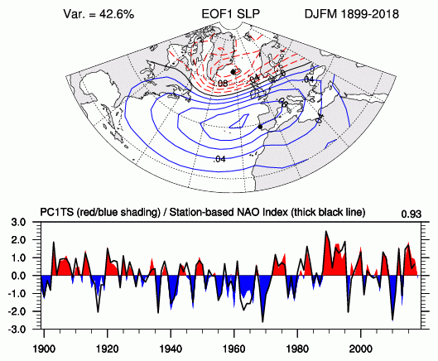
Several questions
3. Do fluxes across the Midwest have a common variability mode?

Slide 25
Several questions
3. Do fluxes across the Midwest have a common variability mode?

Slide 26
Several questions
3. Do fluxes across the Midwest have a common variability mode?

Slide 27
Several questions
3. Do fluxes across the Midwest have a common variability mode?

Slide 28
Several questions
3. Do fluxes across the Midwest have a common variability mode?

Slide 29
Several questions
3. Do fluxes across the Midwest have a common variability mode?

Slide 30
Several questions
4. Can fluxes be estimated remotely from just environmental observations?
Corn
Switchgrass
Prairie
Switchgrass
Reference Grassland
Prairie
Corn

Slide 31
Data relationships
Gap-filling
Respiration
Environmental Observations
Temperature
Surface Fluxes
Photosynthesis
Light
Site 1

Slide 32
Data relationships
Artificial neural networks
?
?
Environmental Observations
?
Surface Fluxes
?
?
?
Site 1

Slide 33
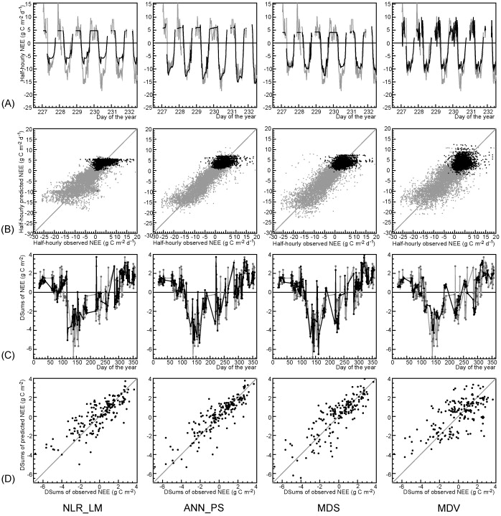
Data relationships
Vs Non-linear regressions, marginal distribution sampling (lookup table), and mean diurnal variation
Environmental Observations
Surface Fluxes
Site 1
Antje M. Moffat et al, Agricultural and Forest Meteorology, 2007
Comprehensive comparison of gap-filling techniques for eddy covariance net carbon fluxes

Slide 34
Data relationships
Expanding relationships beyond one site
Corn
Switchgrass
Prairie
Switchgrass
Reference Grassland
Prairie
Corn

Slide 35
Data relationships
Expanding relationships beyond one site
Environmental Observations
Environmental Observations
Surface Fluxes
Surface Fluxes
Site 1
Site 2

Slide 36
Data relationships
Paired site design
Environmental Observations
Environmental Observations
Surface Fluxes
Surface Fluxes
Site 1
Site 2

Slide 37
What does this look like?
Restored prairie site(s)

Slide 38
What does this look like?
Restored prairie site(s)

Slide 39
What does this look like?
Restored prairie site(s)

Slide 40
What does this look like?

Slide 41
Estimated fluxes, Seasonal

Slide 42
Estimated fluxes, Annual

Slide 43
Error of estimated fluxes

Slide 44
Error of estimated fluxes (paired sites)

Slide 45
Daily versus Hourly modeling

Slide 46
Final question
5. Could information from one site be used to model fluxes from the entire landscape?
Corn
Switchgrass
Prairie
Switchgrass
Reference Grassland
Prairie
Corn

Slide 47
Final question
5. Could information from one site be used to model fluxes from the entire landscape?

Slide 48
Final question
5. Could information from one site be used to model fluxes from the entire landscape?

Slide 49
Final question
5. Could information from one site be used to model fluxes from the entire landscape?

Slide 50
Final question
5. Could information from one site be used to model fluxes from the entire landscape?

Slide 51
Thank you for any feedback
If you’re attending AGU, Jeralyn Poe will be presenting her ½ of this work on Wens
She will be applying for graduate school positions next year

