Slide 1
Multiple Resource Use Efficiency (mRUE) In Agriculture Systems
David E. Reed, Jiquan Chen, Michael Abraha, G. Philip Robertson, Kyla Dahlin
Michigan State University

Slide 2
What Happens When We Have Fewer Assumptions Imbedded Within Our Data?
David E. Reed, Jiquan Chen, Michael Abraha, G. Philip Robertson, Kyla Dahlin
Michigan State University

Slide 3
If Our Data Could Talk, We Assume We Know What It Will Say
In some cases, okay, fine!
Modeled PAR at a site might be okay

Slide 4
If Our Data Could Talk, We Assume We Know What It Will Say
But complex biological systems are noisy

Slide 5
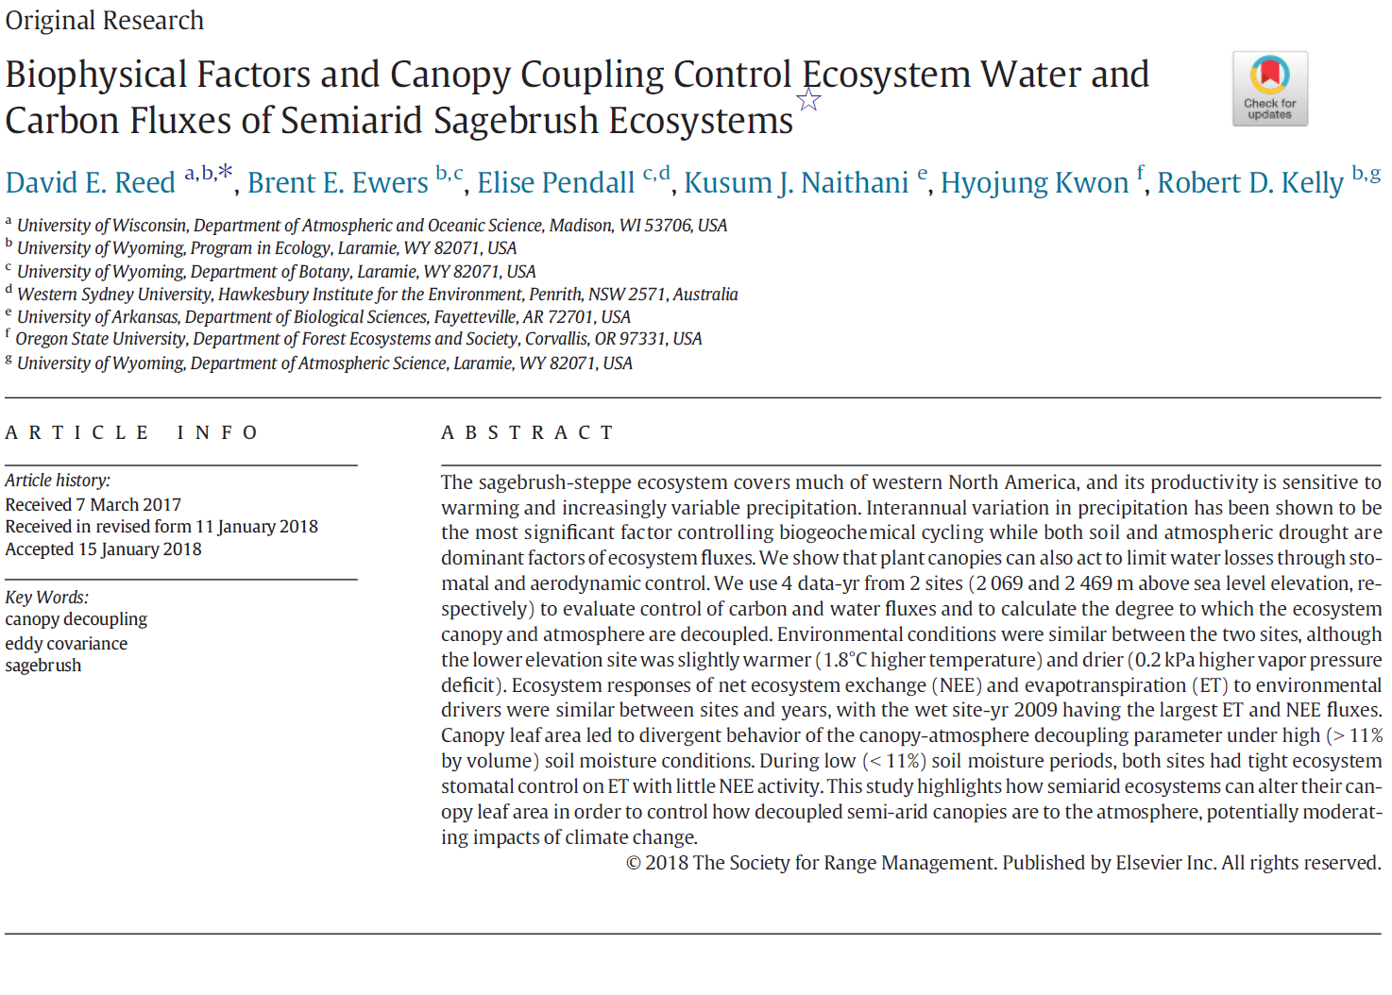
We Assume Relationships
Between Variables
Embedded in the language of drivers/predictors

Slide 6
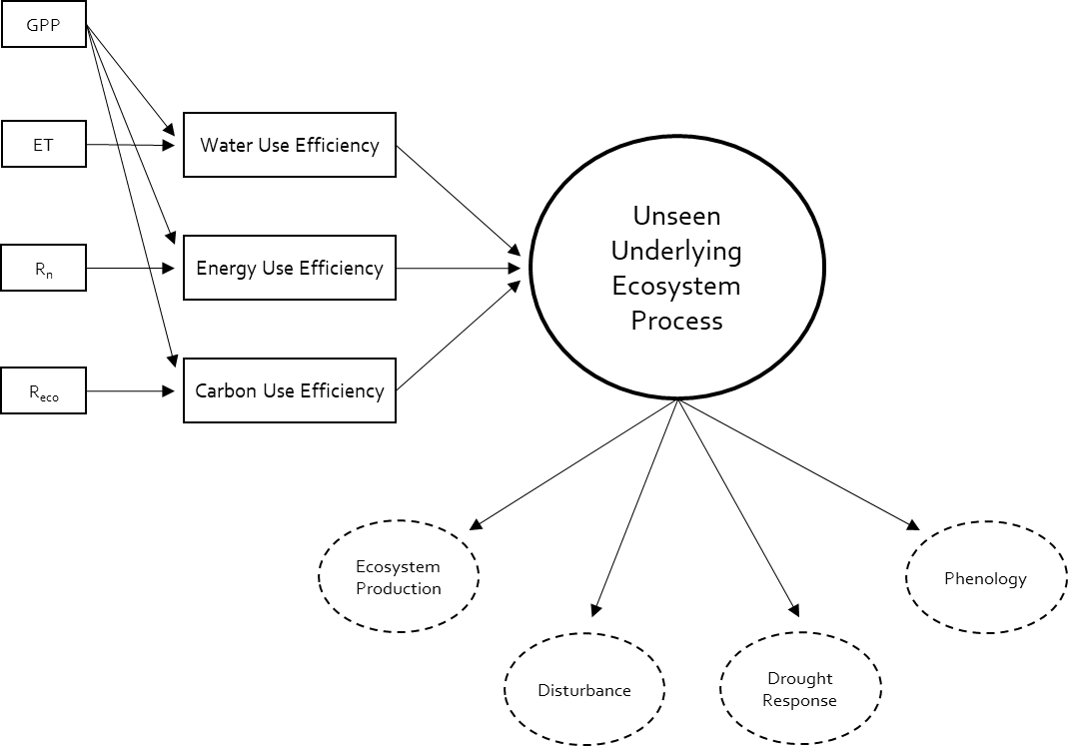
What Happens If We Don’t Assume Any Of This?
Using ecosystem observations, look for a unknown process embedded within the ecosystem

Slide 7
Dynamic Factor Analysis
Similar to Principal Company Analysis
Retains time-series information in the data!
Okay with gaps in that time-series
Multiple ecosystem observations are driven by an unseen state (or multiple states)
This state can be modeled and Loading Factors related to each observation can be solved for

Slide 8
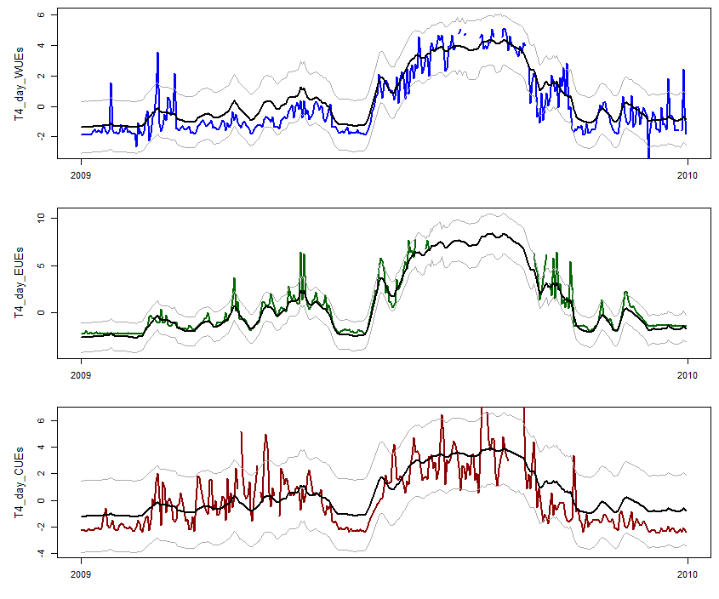
Multiple Resource Use Efficiency
Example site-year (site T4)
Time-series of mRUE overlaid with time-series of model results

Slide 9
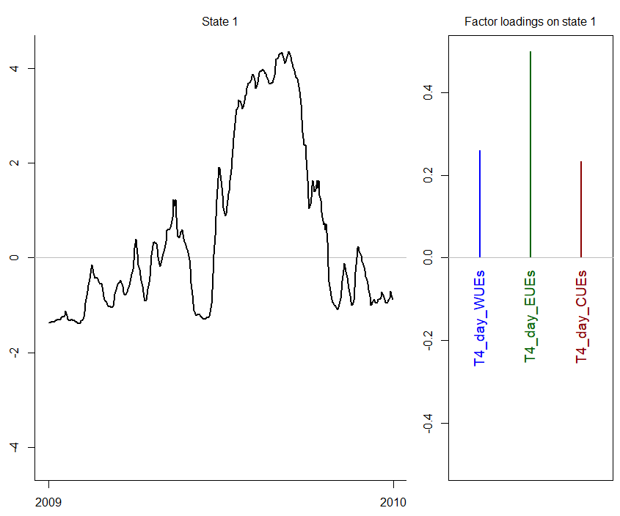
Multiple Resource Use Efficiency
Time-series and loading from unseen state

Slide 10
Multiple Resource Use Efficiency
DFA Model does NOT predict NEP, shown only to illustrate

Slide 11
Multiple Resource Use Efficiency
Available energy dominates annual ecosystem processes
Growing season is energy limited
Mean WUE 0.22
Mean EUE 0.50
Mean CUE 0.22

Slide 12
Multiple Resource Use Efficiency
Within the growing season water and energy are both important
Ecosystems uptake as much carbon as possible, disregarding respiration requirements
Mean WUE 0.65
Mean EUE 0.73
Mean CUE 0.07

Slide 13
Multiple Resource Use Efficiency
Similar story by month in the summer
August energy use becomes more important than water, while carbon use is significantly negative
WUE
1.00->0.86->0.74
EUE
0.99->0.76->0.83
CUE
0.09->-0.02->-0.38

Slide 14
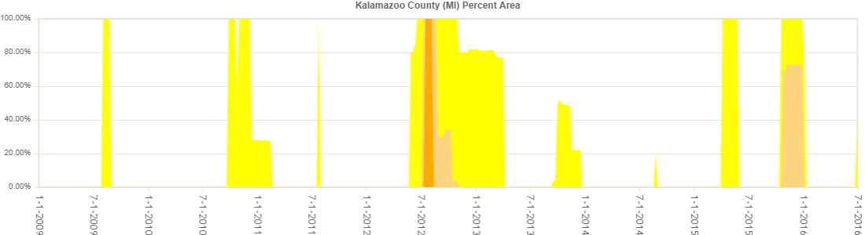
Multiple Resource Use Efficiency
2012, decrease in WUE and EUE in August
Largest draught in >10 years

Slide 15
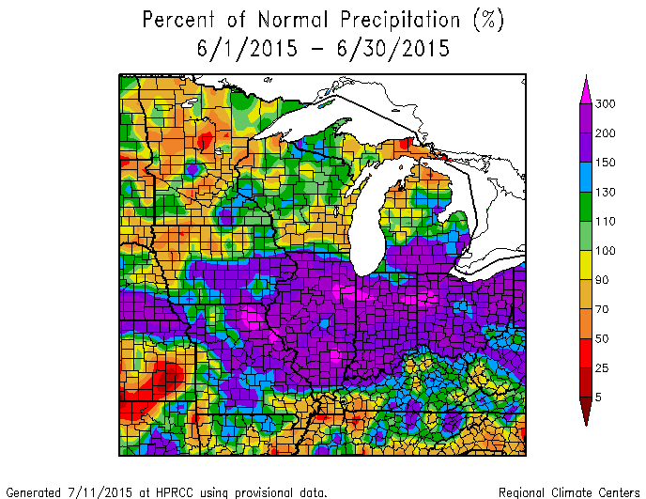
Multiple Resource Use Efficiency
2015
The Midwest's 6th wettest June on record

Slide 16
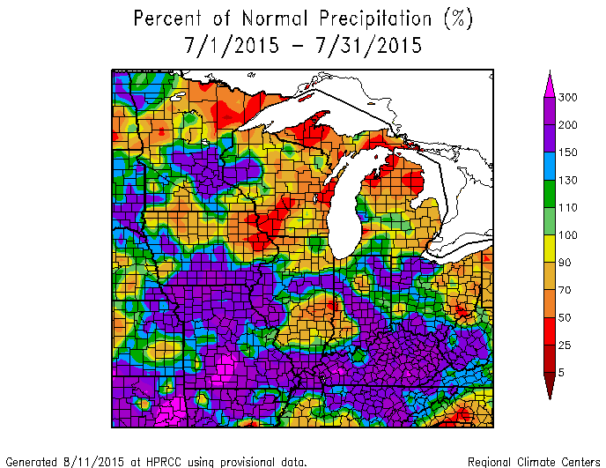
Multiple Resource Use Efficiency
2015
Precipitation continues slightly into July

Slide 17
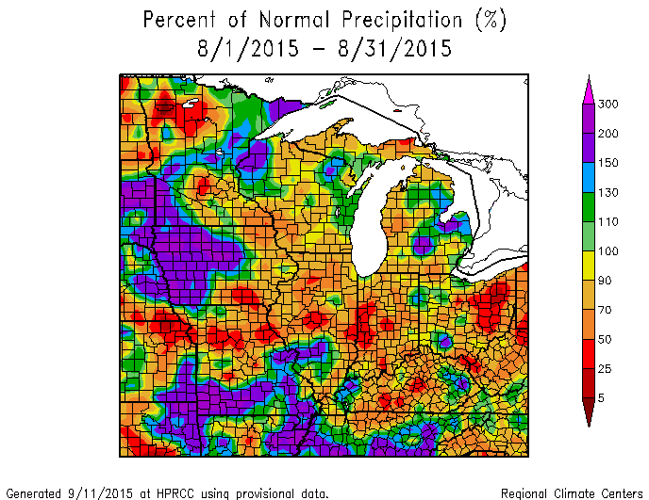
Multiple Resource Use Efficiency
2015
Back to average in August

Slide 18
Multiple Resource Use Efficiency
Energy Use Efficiency has largest loading factor at annual timescales
At smaller timescales, Water and Energy Use dominate
While Carbon Use is a smaller factor

Slide 19
Multiple Resource Use Efficiency
Take Home Points
Novel combined RUE method to quantify and examine un-observed ecosystem processes based on observed time-series
Applicable for multiple ecological applications
Tailor made powerful statistical method for EC datasets

