Slide 1
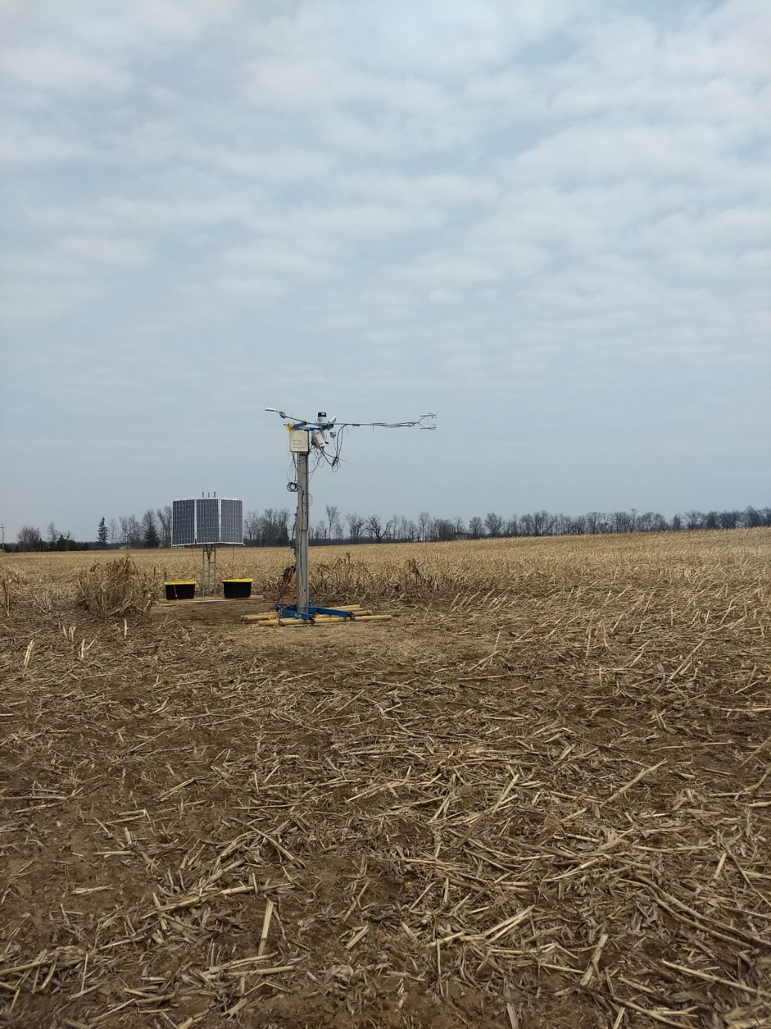
Fluxes from Across the Street
Using Artificial Neural Networks to Model Carbon Cycling from Paired Flux Sites
David E. Reed
Jeralyn M. Poe
Michael Abraha
Jiquan Chen
Michigan State University

Slide 2
Thought experiment

Slide 3
Annual fluxes

Slide 4
Diel processes

Slide 5
Hypothetical 2nd measurement

Slide 6
Coherent signals

Slide 7
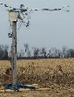
Still coherent?

Slide 8
Still coherent?

Slide 9
To what extent is information from a single eddy covariance footprint useful outside of that footprint?

Slide 10
Exploring This Question
Utilize highest density flux network
Cluster of 13 Michigan sites within <50 mile radius
Cluster of 4 Wisconsin Sites

Slide 11
Several Approaches
Time-Series Analysis
Geospatial Statistics
Model-Data Fusion

Slide 12
Several Approaches
Time-Series Analysis
Do ecosystem fluxes have a common mode of variability?
B33I-2799: Spatial coherence of carbon flux towers in Midwest ecosystems

Slide 13
Several Approaches
Geospatial Statistics
At what distance are ecosystem variability modes coherent?
Nugget
Coherence
Sill
Range
Distance

Slide 16
Several Approaches
Model-Data Fusion

Slide 17
Gap Filling As
Model-Data Fusion
Respiration
Environmental Observations
Temperature
Surface Fluxes
Photosynthesis
Light
1 Site

Slide 18
Artificial Neural Networks
?
?
Environmental Observations
?
Surface Fluxes
?
?
?
1 Site

Slide 19
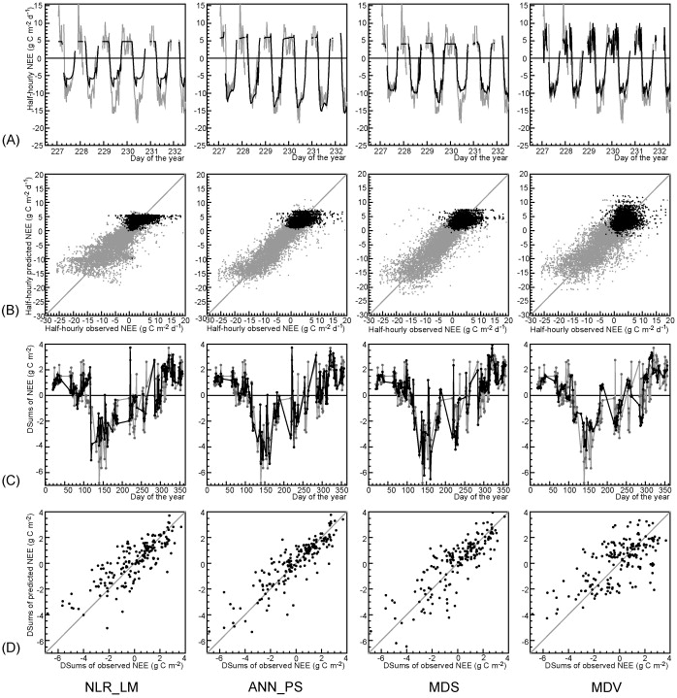
Data relationships
Vs Non-linear regressions, marginal distribution sampling (lookup table), and mean diurnal variation
Environmental Observations
Surface Fluxes
1 Site
Antje M. Moffat et al, Agricultural and Forest Meteorology, 2007
Comprehensive comparison of gap-filling techniques for eddy covariance net carbon fluxes

Slide 20
Paired Site Design at MSU’s LTER
Environmental Observations
Environmental Observations
Surface Fluxes
Surface Fluxes
Site 1
Site 2

Slide 21
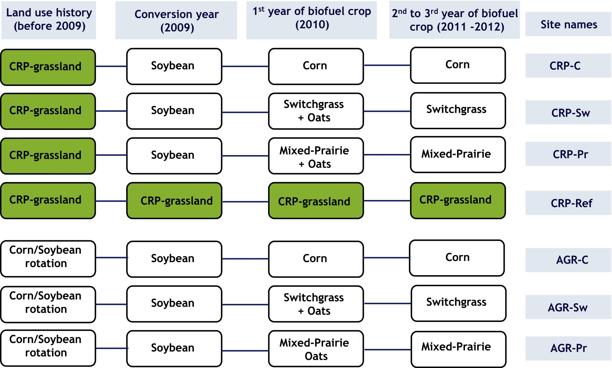
MSU’s LTER
Different land use histories, we’ll chose to ignore this for today
Abraha, M. , Chen, J. , Chu, H. , Zenone, T. , John, R. , Su, Y. , Hamilton, S. K. and Robertson, G. P. (2015), Evapotranspiration of annual and perennial biofuel crops in a variable climate. GCB Bioenergy, 7: 1344-1356. doi:10.1111/gcbb.12239

Slide 22
Daily and 30-Minute Fluxes
48 Site-Years
Environmental Observations
Environmental Observations
Surface Fluxes
Surface Fluxes
Site 1
Site 2

Slide 23
What does this look like?

Slide 24
What does this look like?

Slide 25
What does this look like?

Slide 26
What does this look like?

Slide 27
What does this look like?

Slide 28
Estimated fluxes, Seasonal

Slide 29
Estimated fluxes

Slide 30
Estimated fluxes

Slide 31
Estimated fluxes at Six Sites

Slide 32
Estimated fluxes at Six Sites

Slide 33
To what extent is information from a single eddy covariance footprint useful outside of that footprint?

Slide 34
To what extent is information from a single eddy covariance footprint useful outside of that footprint?

Slide 35
To what extent is information from a single eddy covariance footprint useful outside of that footprint?

Slide 36
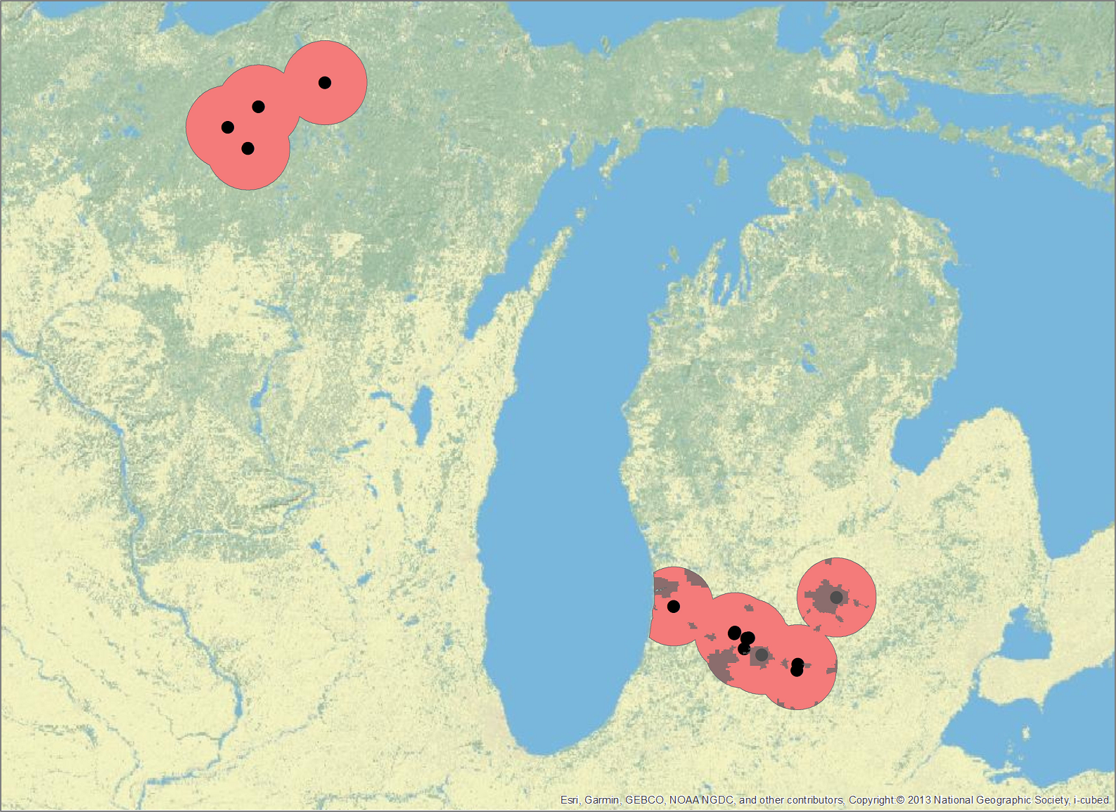
To what extent is information from a single eddy covariance footprint useful outside of that footprint?

Slide 37
Thank you for any feedback
Jeralyn Poe will be presenting her ½ of this work tomorrow
B33I-2799: Spatial coherence of carbon flux towers in Midwest ecosystems
She will be applying for graduate school positions next year

