Slide 1
Understanding the Interconnectedness of Water Resources and Electricity Supply: A Case Study of Human-Environment Interactions in Energy Systems
Xin Lan
Ph.D. Student | Department of Geography, Environment, and Spatial Sciences
Ph.D. Student | Environmental Science and Policy Program (Doctoral Dual Major)
Michigan State University, College of Social Science

Slide 2
01
PART ONE
﻿﻿Introduction

Slide 3
Climate change: a fact we must confront
The global average surface temperature has increased by 1.3 ℃ since the Industrial Revolution (Davis et al., 2010).
The subtropics and middle latitudes have been becoming drier due to climate change (Putnam & Broecker, 2017).
1st Question: how does climate change affect water resources?

Slide 4
Power production requires water for cooling
Thermoelectric power plants account for 91% of US electricity production (Van Vliet et al., 2012).
In 2005, thermoelectric power accounted for 41% of all freshwater withdrawals (Tidwell et al., 2012).
2nd Question: how do water resource changes affect power generation?

Slide 5
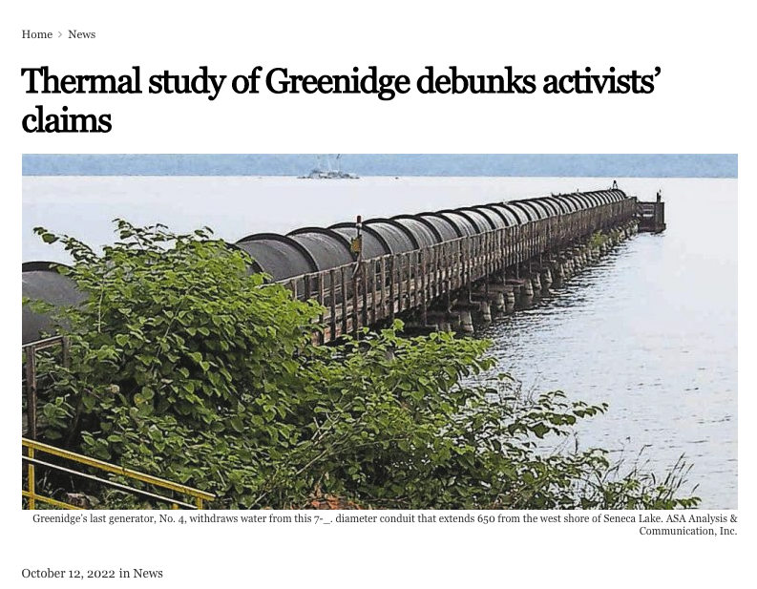
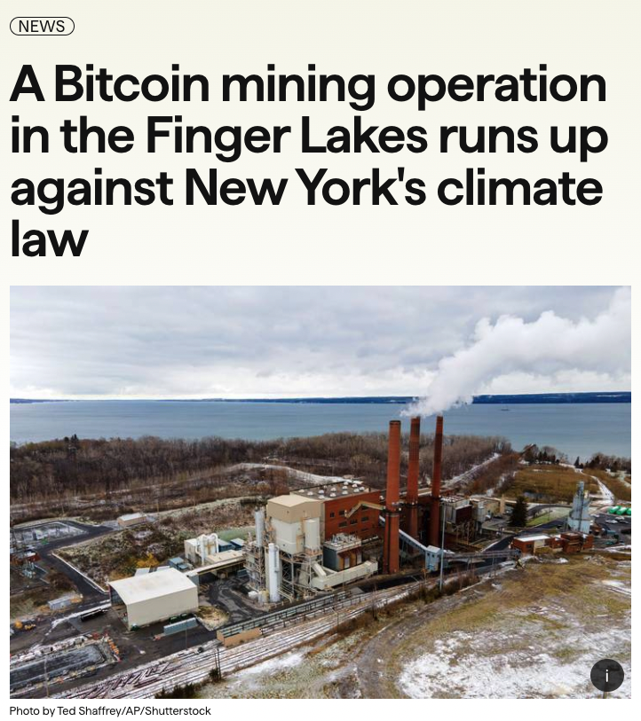
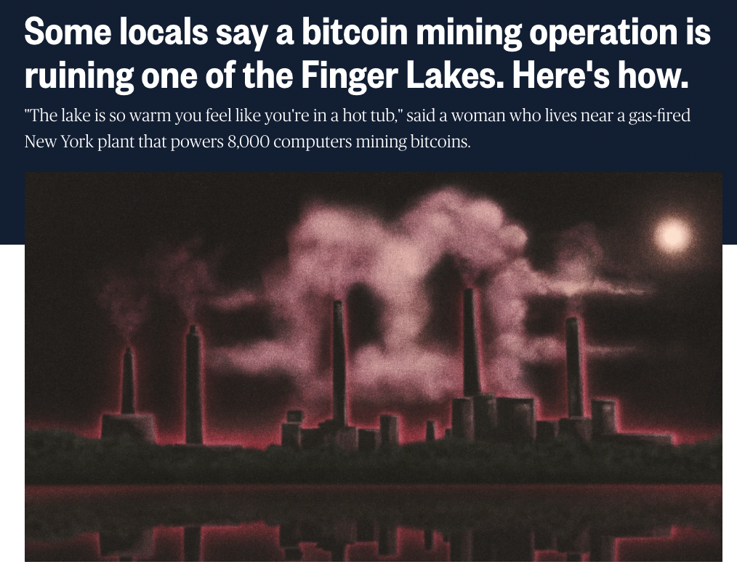
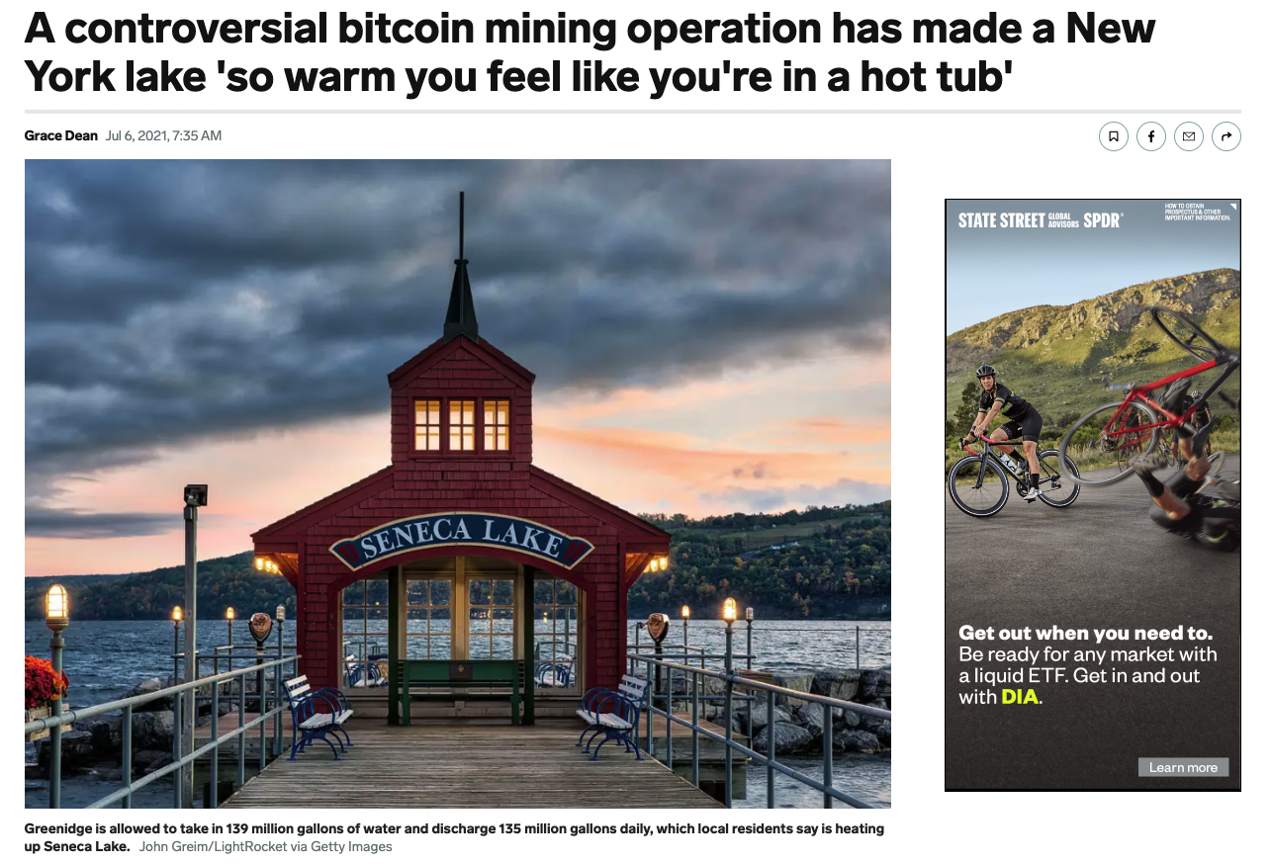
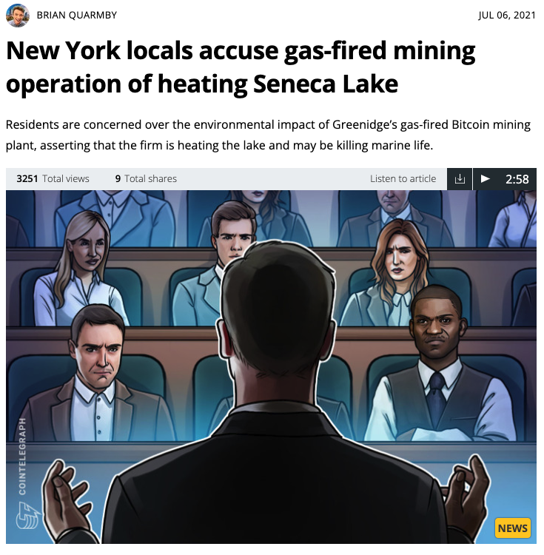
Impact of the power plant on water warming
A significant positive correlation was limited to the lake's northern half (lake water flows from south to north).
3rd Question: how does thermal pollution affect water temperature nationally?

Slide 6
02
PART TWO
﻿﻿Data and Method

Slide 7
Data Source
Sources of Data Utilized in this Research
Environmental Factors
Water Temperature | 1980-2020 | United States Geological Survey
Stream Flow | 1980-2020 | United States Geological Survey
Human Factors
Cooling Water Withdrawal | 2016-2020 | United States Energy Information Administration
Cooling Water Temperature | 2016-2020 | United States Energy Information Administration
Electricity Rates | 2016-2020 | United States Energy Information Administration
Energy Source for Power Generation | 2016-2020 | United States Energy Information Administration
Locations of Power Plants | 2016-2020 | United States Energy Information Administration

Slide 8
Research Methods
1st Question: how does climate change affect water resources?
Trend analysis (Theil–Sen estimates with the Mann-Kendall Trend Test).
2nd Question: how do water resource changes affect power generation?
Sensitivity analysis: estimate the impact on power production efficiency.
Random forest: determine the important factors in explaining the usable power capacity.
3rd Question: how does thermal pollution affect water temperature nationally?
Path analysis: describes the direct and indirect relationship between exogenous and endogenous variables.
Currently processing remote sensing data on water temperatures and conducting simulations using hydraulic models to gather stream flow data (plan for future work).

Slide 9
03
PART THREE
﻿Results

Slide 10
Effects of climate change on water resources
The southwestern United States experiences frequent droughts, possibly due to its semi-arid and desert climates.
Our results indicate that water temperatures are increasing throughout the entire United States.
Water warming is nationwide, with drought in the southwest.

Slide 11
Effects of water resources on production efficiency
The efficiency of electricity production may not be significantly affected by water temperatures.
Withdrawing more cooling water may slightly enhance the efficiency of electricity production.
The impact of alterations to water resources on efficiency is relatively low.

Slide 12
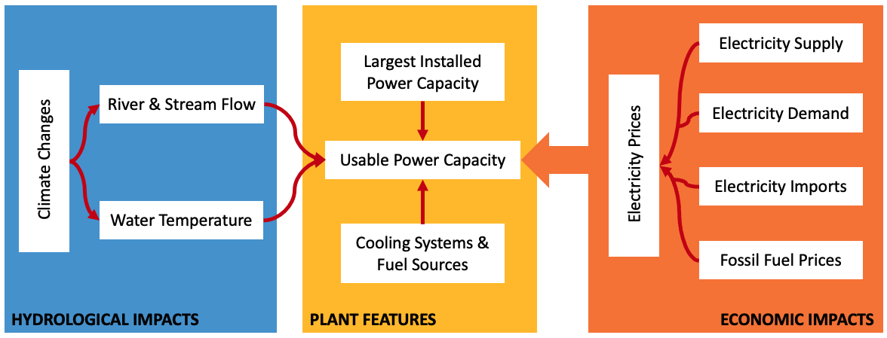
Effects of water resources on usable power capacity
The siting of power plants and cooling water withdrawal are key factors in determining usable capacity, while fuel type, electricity price, and water temperature have relatively less significance.
The primary factor affecting usable capacity is cooling water withdrawal.

Slide 13
04
PART FOUR
Conclusion

Slide 14
Conclusion
Take-home message:
1st Question: water warming is frequently observed in the contiguous United States, while droughts typically occur in the southwestern region.
2nd Question: water temperature has a minor impact on production efficiency, and withdrawing more water may slightly enhance it. In summary, changes to water resources have a low impact on efficiency.
2nd Question: the siting of power plants and cooling water withdrawal is critical for determining usable capacity, while fuel type, electricity price, and water temperature are less significant.

Slide 15
Future Work
1st potential direction:
Data sources: Landsat Level 2 Land Surface Temperature products & VIC/CLM Model streamflow output.
Method: Path analysis to describe the interconnectedness of water resources and electricity supply.
2nd potential direction:
Predict power demand under climate change ﻿with future projections of population and income under five socioeconomic scenarios.
Predict power supply under climate change ﻿with future projections of water temperatures and stream flow under different Representative Concentration Pathway (RCP) scenarios.

Slide 16
Reference
Davis, S. J., Caldeira, K., & Matthews, H. D. (2010). Future CO2 emissions and climate change from existing energy infrastructure. Science, 329(5997), 1330-1333.
Putnam, A. E., & Broecker, W. S. (2017). Human-induced changes in the distribution of rainfall. Science Advances, 3(5), e1600871.
Tidwell, V. C., Kobos, P. H., Malczynski, L. A., Klise, G., & Castillo, C. R. (2012). Exploring the water-thermoelectric power nexus. Journal of Water Resources Planning and Management, 138(5), 491-501.
Van Vliet, M. T., Yearsley, J. R., Ludwig, F., Vögele, S., Lettenmaier, D. P., & Kabat, P. (2012). Vulnerability of US and European electricity supply to climate change. Nature Climate Change, 2(9), 676-681.

