Slide 1
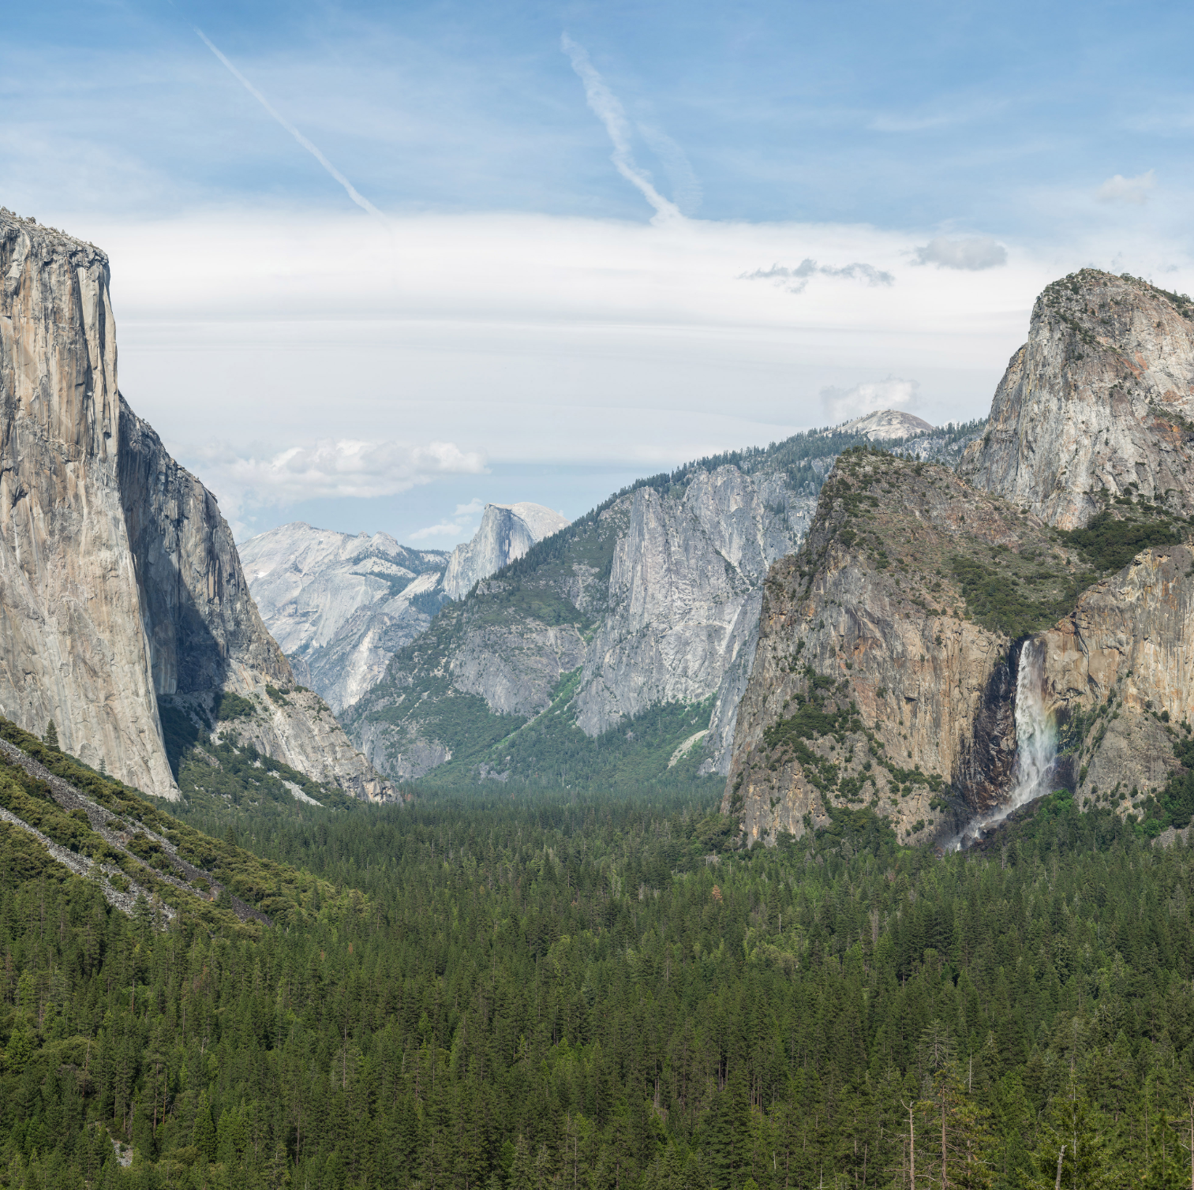
Social Ecological Systems in Denali National Park
By: CarLee Stimpfel
Graduate Student @MSU
Stimpfe1@msu.edu

Slide 2
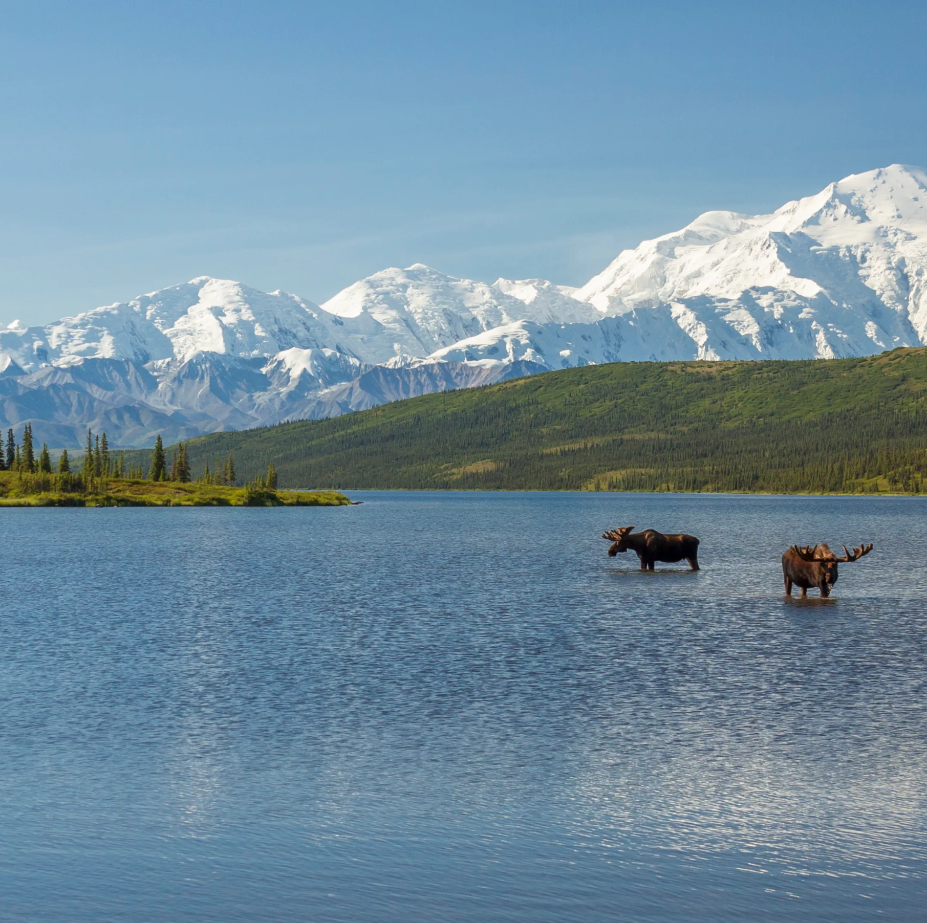
Denali National Park
Located in Alaska, USA
6 million acres of land
Receives 600,000 visitors each year.
Protect aesthetic, function, and cultural values.
Local region supported by tourism

Slide 3
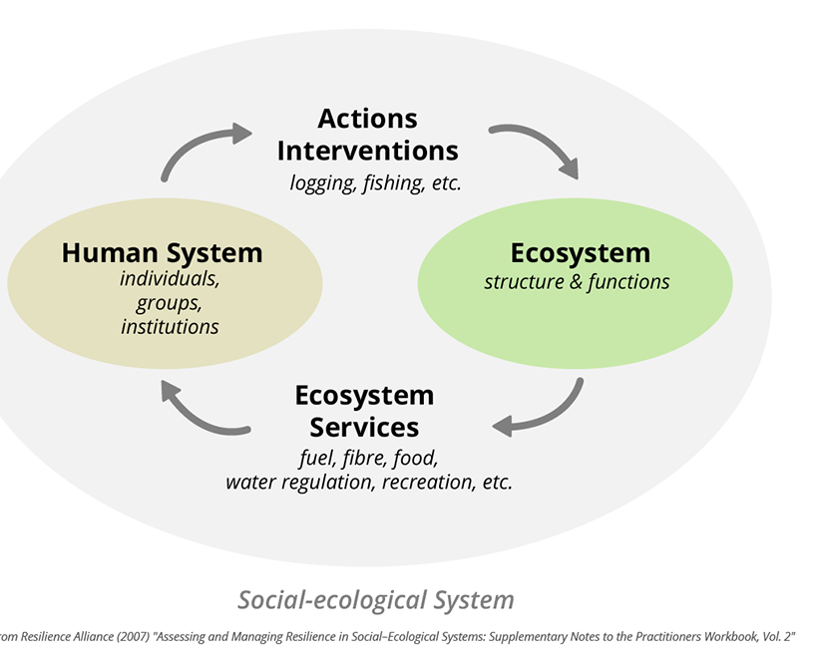
What Is SES
Social Ecological Systems
"Humans and Nature”
interaction between humans and nature
proper management of the resources requires stakeholder engagement
National parks cannot function alone separate from social and ecological forces outside of the park but must function with those outside forces.

Slide 4
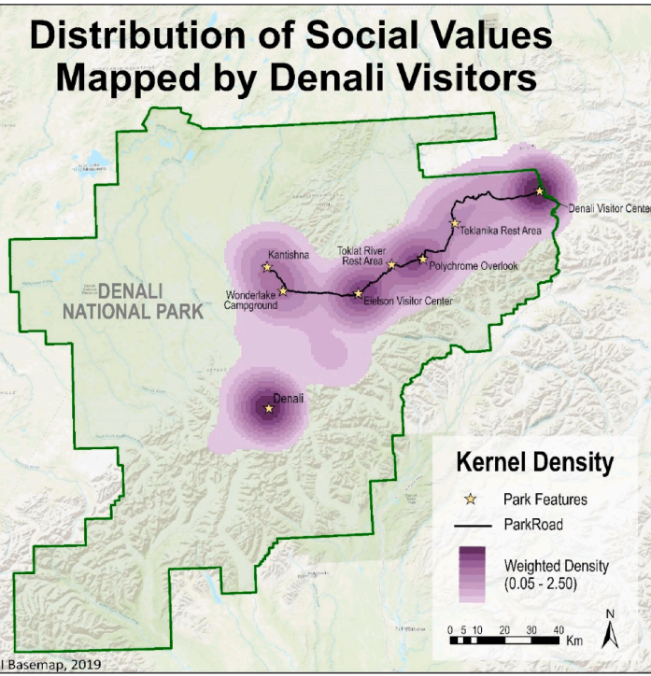
Stakeholder and Community Engagement
facilitation of community engagement is vital to a successful national park.
open communication early on allows for full understanding equaling less push back.
Thousands of tourists support the local economies.
The values of those visiting must be upheld to keep visitors coming back.

Slide 5
Fuzzy Cognitive mapping
Obtaining data on how local people perceive SES in the national park.
Data collection method to understand locals perceived thoughts.
Done through both individual and group interviews on the topic of SES.
span socioeconomic, socio-cultural, and ecological dimensions,
Drivers of Change
Tourism, wilderness, subsistence, and sense of community most central to the system.

Slide 6
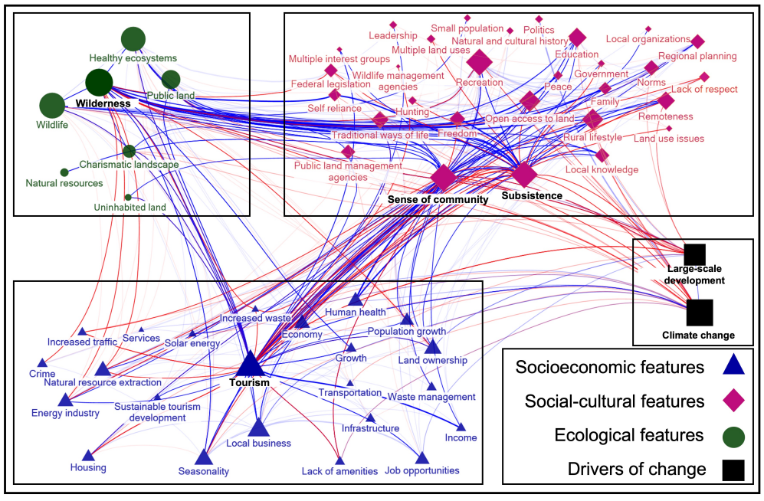

Slide 7
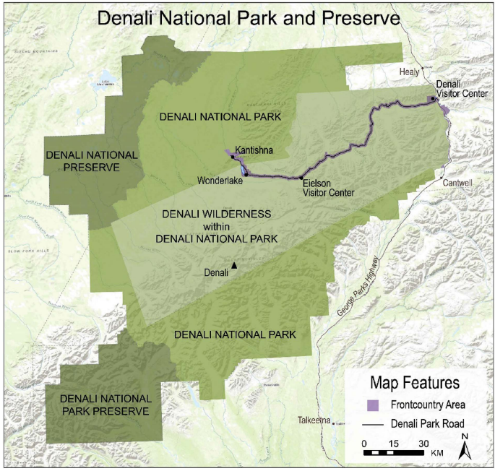
Front Country and Back Country
Front country within ½ mile of road and infrastructure
Back Country ½ of the road in the wilderness
87 sections of back country only 1600 permits
Two different views of the landscape

Slide 8
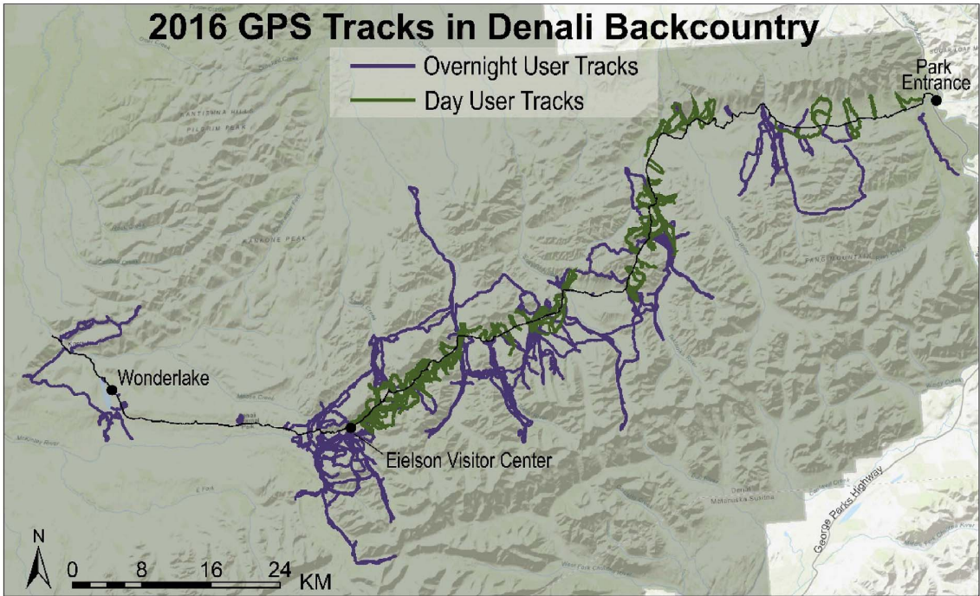
GPS Tracking
Majority of the recreation occurred very close to the park road.
Backcountry backpackers showed a very undispersed hiking and camping pattern.
Backcountry backpacking meant to increase dispersal and reduce environmental damages.
Users tend to do the opposite and use the same areas creating hot spot.
Back country backpackers follow other routes and go to the same feature.

Slide 9
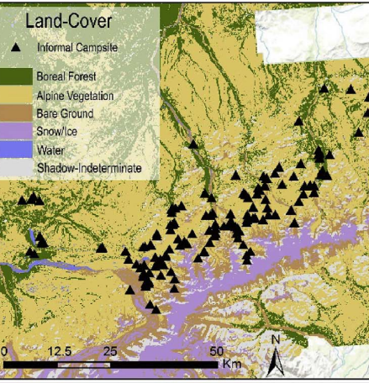
Climate Change
Presented major challenges for national parks
Each park has a fine dynamic that must be maintained.
Pressure on stakeholders to communicate with local communities to determine what the best option.
Realized benefit to involving local communities in understanding the changes occurring

Slide 10
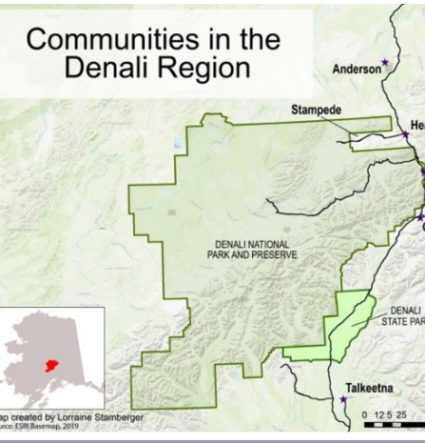
Community Observation
Long term community members were interviewed about their lived experience
Provided deep detail other than just science
Allowed management groups to understand what local people are perceiving
98% reported that they had seen the impacts of climate change on the region.
warmer climates, faster plant growth, reduced snow fall and lower water levels

Slide 11
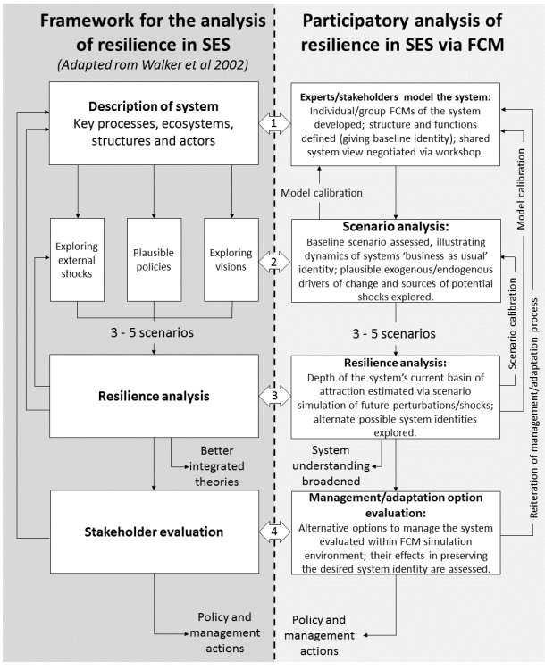
System resilience
ability of a system to return to a "normal" after experiencing some form of intrusion
conditions it returns to are based upon the region's identity, structure, and system function
SES’s will and can exist in multiple states and is fundamental to resilience

Slide 12
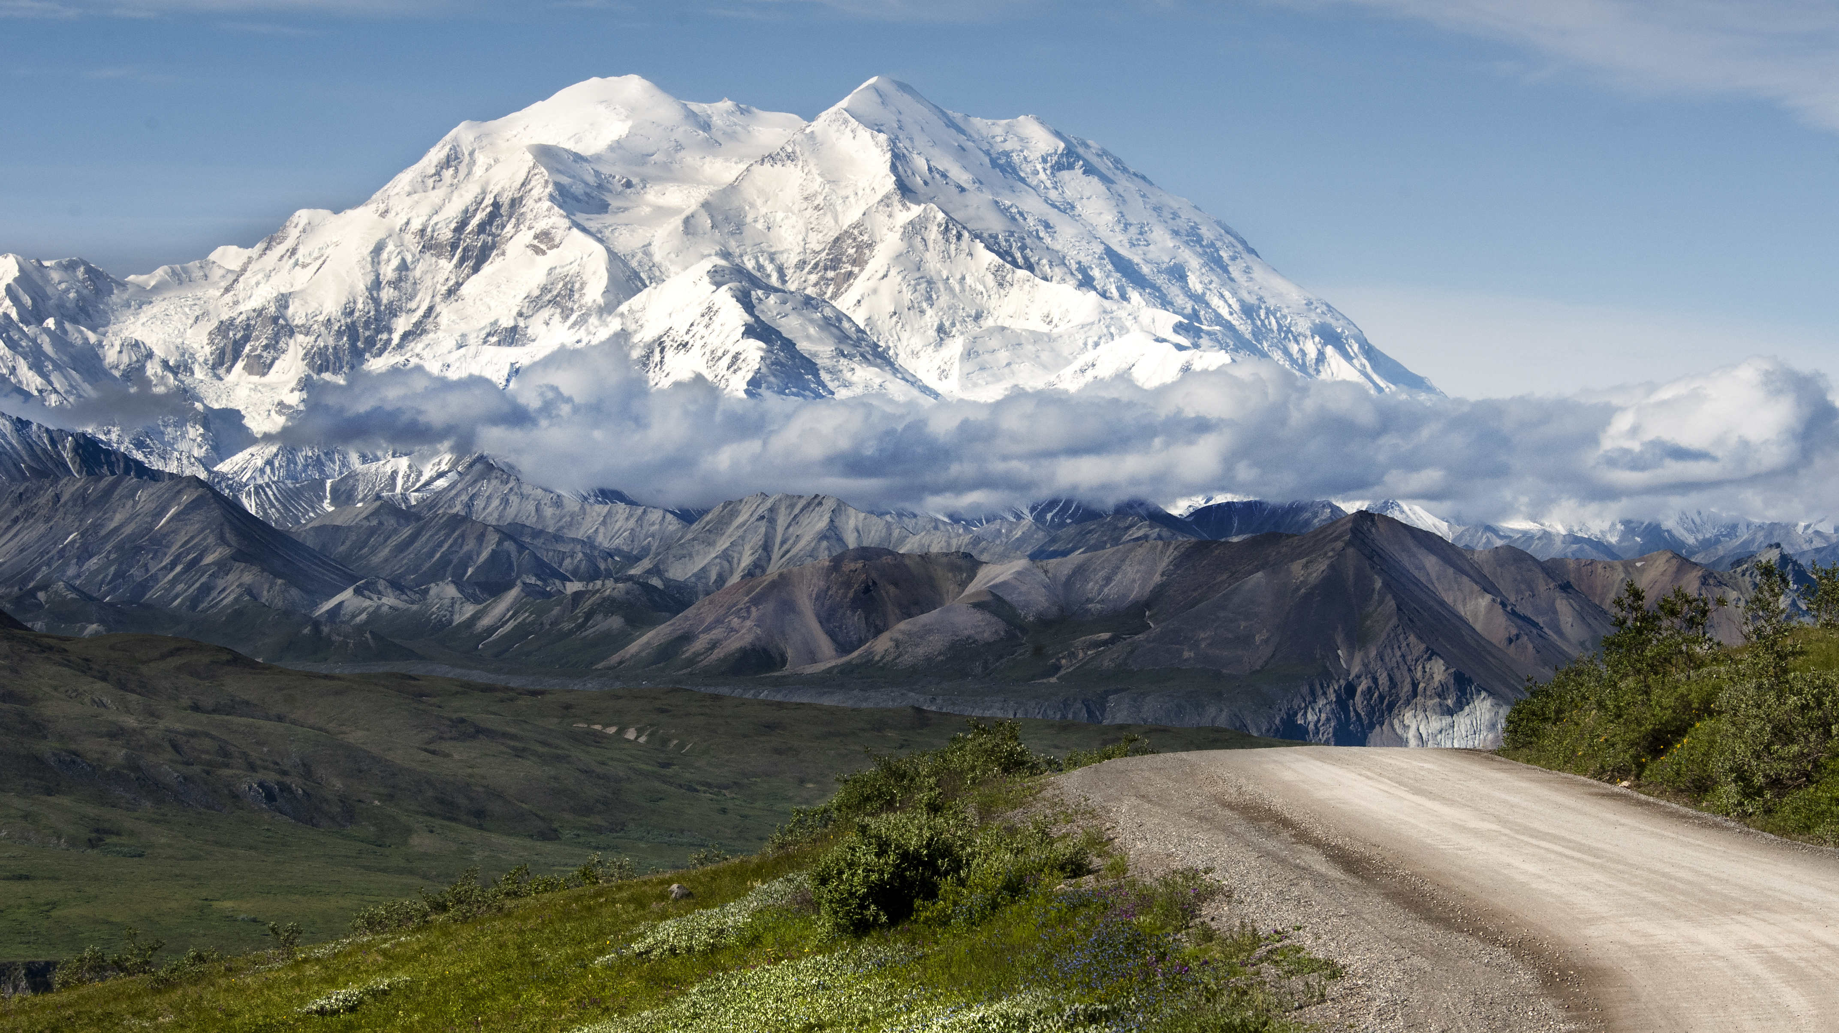
The End Thank You For Your Time! Questions?

