Slide 1
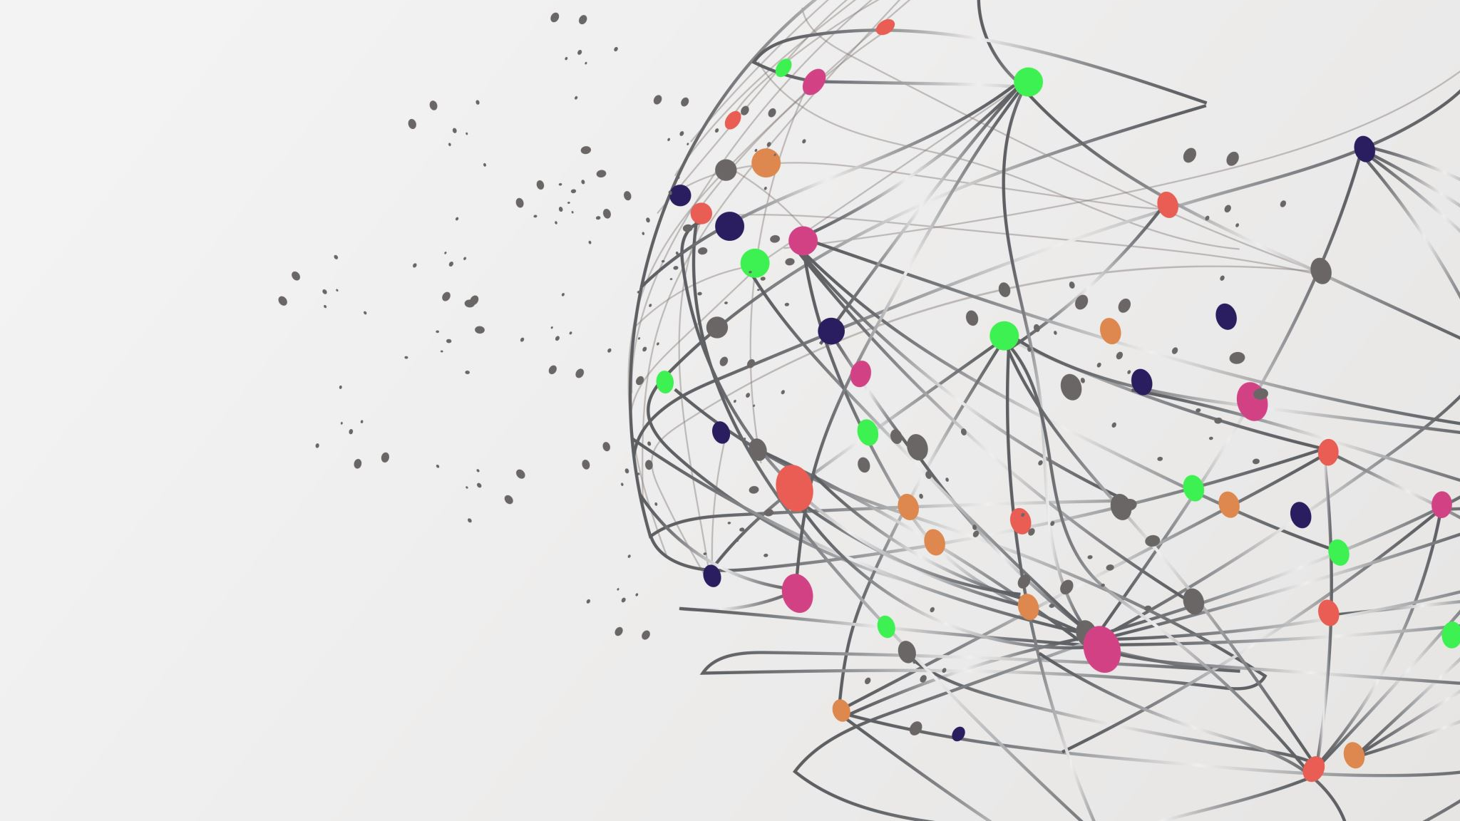
Creating a meta-coupled framework to address Amazonian pasture-based deforestation
Presenter: Michaela Shope

Slide 2
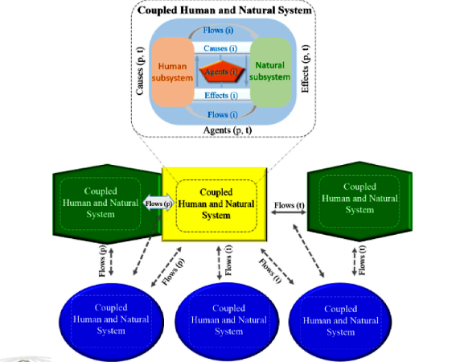
Background – Meta-coupling
Two or more coupled systems that interact internally, nearby, and far away.
Meta-coupling includes intra-coupling, telecoupling, and peri-coupling
Intra-coupling: couplings within the system
Telecoupling: couplings between far apart systems
Peri-coupling: couplings between nearby systems
Multi-scalar
Taken from Liu 2017
Notes:
Liu et al., 2007
Wang et al., 2018
Stevenson 2011
Liu, 2017
Liu et al., 2021

Slide 3
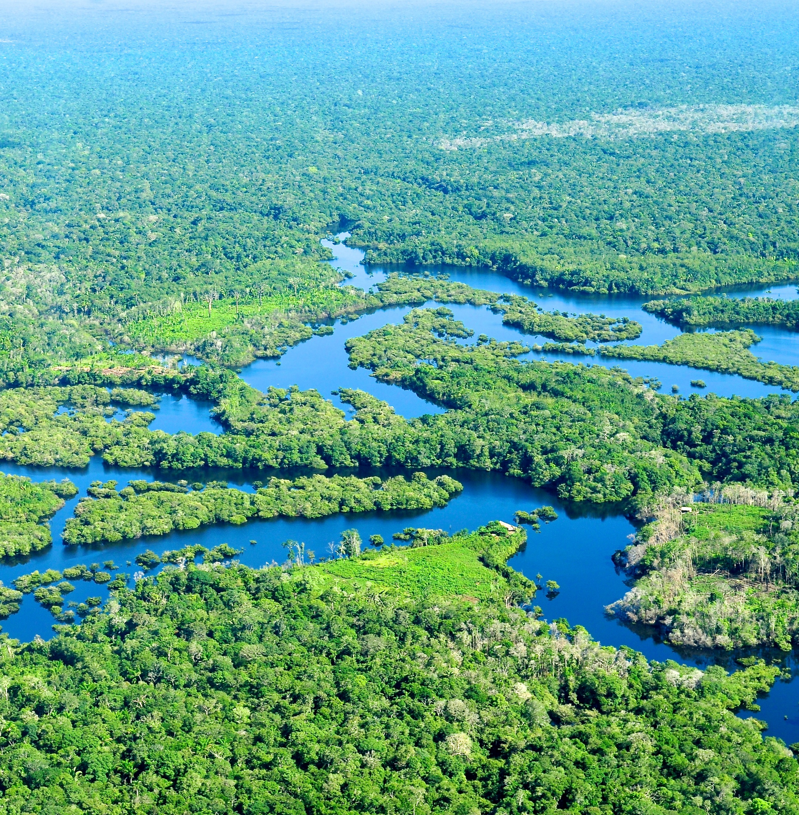
Background – Amazon Rainforest
Largest rainforest in the world, with highest level of biodiversity
Leading cause (2/3rd) of deforestation is creation of pasture
Brazil is the number one exporter of beef
>70% of Brazilian beef is consumed internally
Notes:
Ferraz and Felicio, 2010 – 72.5% internal consumption and largest beef exporter in world
Ermgassen et al., 2020 – “Two-thirds of cleared land in the Amazon and Cerrado biomes have been converted to cattle pasture (16), making the Brazilian cattle sector responsible for one-fifth of all emissions from commodity-driven deforestation across the entire tropics (17)”./biggest beef exporter/exports 1/5 of production
Vale et al., 2019 - “Systems of beef production are inevitably tied to food security”
Nepstad et al., 2006 – mentions teleconnections and BSE
Picture- national geographic https://education.nationalgeographic.org/resource/amazon-rainforest/

Slide 4
Human Subsystem
Natural Subsystem
Pasture Degradation
Cattle Ranchers Association
Producers
Amazonian deforestation
Production
Pasture
Local Demand
Transportation
Biodiversity Loss
Cattle
Cow-based Products
Ranch Owners
Vendors
Emissions
Soil Fertility Loss
Nutrition
River Damage
Employment/
Local Income
Agricultural Production
Forest Products
Quality of Life
Cattle Ranchers
Consumers
Runoff/Pollution
Cattle-Human Disease
Notes:
Intra-coupling
Example of potential intra-coupling framework for case study
Red = effect or product
Black = agent
Green = mechanisms/flow/cause\
Employment is also local income

Slide 5
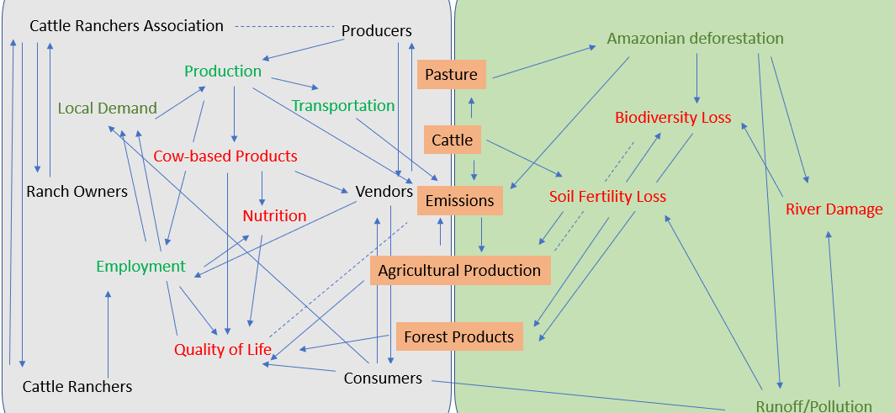
Human Subsystem
Natural Subsystem
HydroPower/Energy Generation
Regional/National Hydrologic cycle
Political Approval
Pasture Degradation
Government/
Policy Makers
Policy
Cattle-Human Disease
Regional/National
Biodiversity Loss
Environmentalists
Displacement
Anti-deforestation measures
Degradation of the Cerrado
Tourism
GDP
Notes:
Peri-coupling

Slide 6
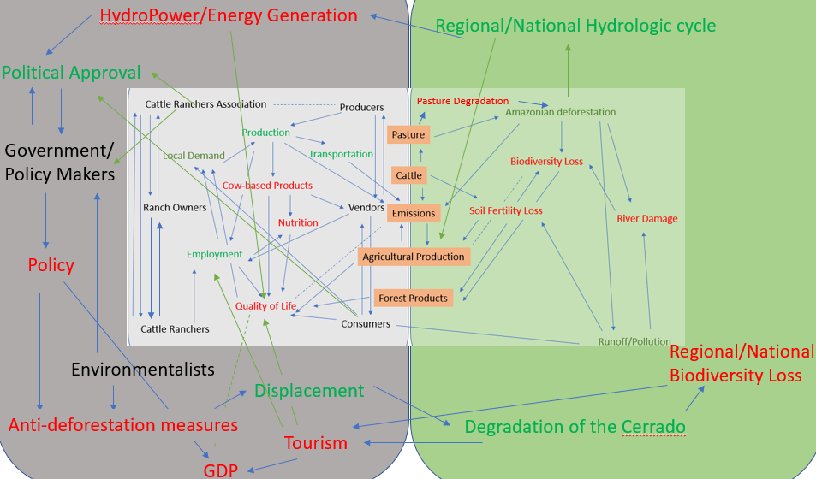
Human Subsystem
Natural Subsystem
Climate Change
Global Hydrologic Cycle
International Policy Makers
Emissions
Regional/National Hydrologic cycle
Global Temperature
Anomalies
International Policy
Transportation
Other Nations
(China, Russia,
US, UK, Australia)
Cattle-Human Disease
Brazil
Export/Import
International Demand
Natural Disasters
Notes:
Tele-coupling

Slide 7
Findings
Without peri-coupling variables/relationships are omitted (e.g.):
Tourism → Quality of life
Degradation of the Cerrado
Amazonian deforestation → Regional/national hydrologic cycle
Hydropower/Energy Creation
GDP
Consumers → political approval
Without telecoupling variables/relationships are omitted:
International demand
Policy → export/import
Other nations
International policy → regional policy
Climate Change
Regional hydrologic cycle → Climate change
Without meta-coupling variables/relationships are omitted:
Climate change → quality of life
Amazonian deforestation → Climate change
Climate change → human-cattle disease
Agricultural production → export/import
Climate change → Agricultural production

Slide 8
Conclusion
Each additional layer of coupling adds elements
Meta-coupling allows for cross/multi-scalar analyses and relationships
The collective is greater than the sum of the composite pieces
The Deforestation-pasture nexus is a complex system best studied with CHANS or other systems dynamics approaches (i.e., causal loop diagramming, machine learning, etc.)

Slide 9
References
Nepstad, D. C., Stickler, C. M., & Almeida, O. T. (2006). Globalization of the Amazon soy and beef industries: opportunities for conservation. Conservation biology, 20(6), 1595-1603.
Liu, J., Dietz, T., Carpenter, S. R., Alberti, M., Folke, C., Moran, E., ... & Taylor, W. W. (2007). Complexity of coupled human and natural systems. science, 317(5844), 1513-1516.
Wang, S., Fu, B., Zhao, W., Liu, Y., & Wei, F. (2018). Structure, function, and dynamic mechanisms of coupled human–natural systems. Current Opinion in Environmental Sustainability, 33, 87-91.
Ferraz, J. B. S., & de Felício, P. E. (2010). Production systems–An example from Brazil. Meat science, 84(2), 238-243.
Stevenson, R. J. (2011). A revised framework for coupled human and natural systems, propagating thresholds, and managing environmental problems. Physics and Chemistry of the Earth, Parts A/B/C, 36(9-11), 342-351.
Liu, J. (2017). Integration across a metacoupled world. Ecology and Society, 22(4).
Vale, P., Gibbs, H., Vale, R., Christie, M., Florence, E., Munger, J., & Sabaini, D. (2019). The expansion of intensive beef farming to the Brazilian Amazon. Global Environmental Change, 57, 101922.
Zu Ermgassen, E. K., Godar, J., Lathuillière, M. J., Löfgren, P., Gardner, T., Vasconcelos, A., & Meyfroidt, P. (2020). The origin, supply chain, and deforestation risk of Brazil’s beef exports. Proceedings of the National Academy of Sciences, 117(50), 31770-31779.
Liu, J., Dietz, T., Carpenter, S. R., Taylor, W. W., Alberti, M., Deadman, P., ... & Lubchenco, J. (2021). Coupled human and natural systems: The evolution and applications of an integrated framework: This article belongs to Ambio’s 50th Anniversary Collection. Theme: Anthropocene. Ambio, 50, 1778-1783.

Slide 10
Human Subsystem
Natural Subsystem
Climate Change
Global Hydrologic Cycle
International Policy Makers
Emissions
Regional/National Hydrologic cycle
Global Temperature
Anomalies
International Policy
Transportation
Other Nations
(China, Russia,
US, UK, Australia)
Cattle-Human Disease
Brazil
Export/Import
International Demand
Natural Disasters
Notes:
Tele-coupling

