Slide 1
Telecoupling Impact of the Russia-Ukraine War since 2022
Yuean Qiu; 04-26-2023

Slide 2
Contents
Background & Objectives
Food crisis in Africa
Deforestation in Brazil
Discussion & Conclusion

Slide 3
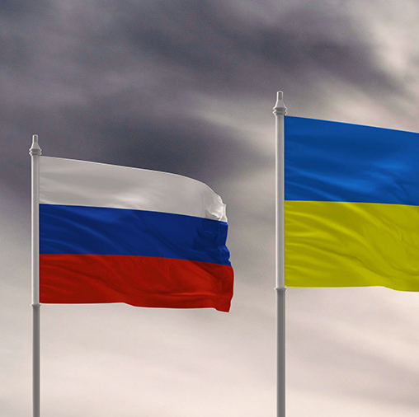
Background & Objectives
Russia’s full-scale invasion of Ukraine since Feb 24th, 2022
War: tremendous negative impacts on social-ecological systems (SES)
Death; Refugee; Hunger
Habitat loss
Intensive discussion in Europe (Pericoupling)

Slide 4
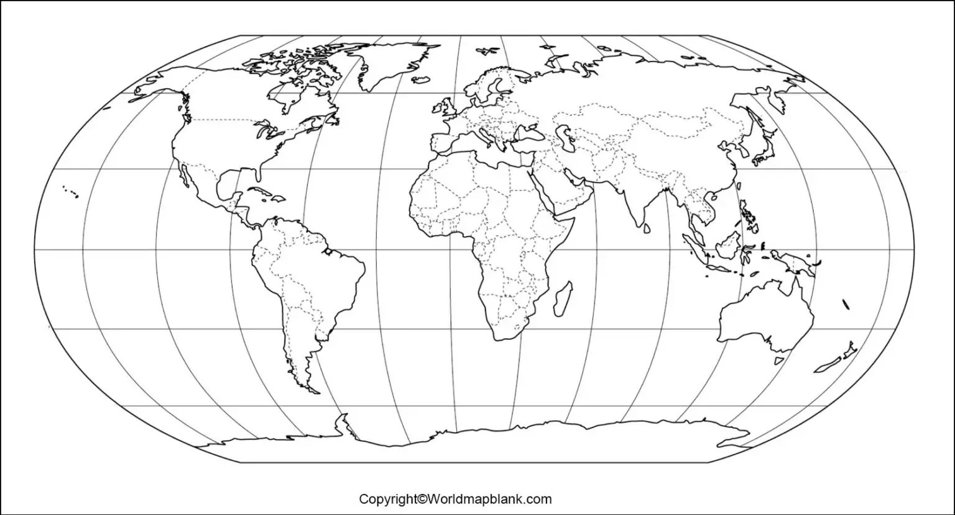
The less-noticed receivers – Africa & Brazil
War

Slide 5
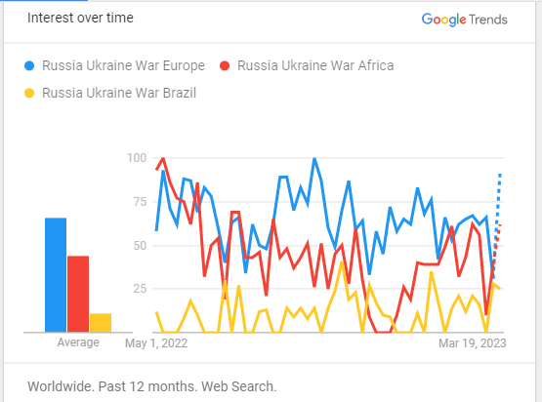
The less-noticed receivers – Africa & Brazil
Two empirical indicators: Google Trends (left), #Docs in Scopus Database (right)
Top-down: Russia And Ukraine And war And 1) Europe, 2) Africa, 3) Brazil

Slide 6
Background & Objectives
Objectives:
1) describe the telecoupling impacts of the war on Africa and Brazil;
2) discuss potential modification of a SES framework.

Slide 7
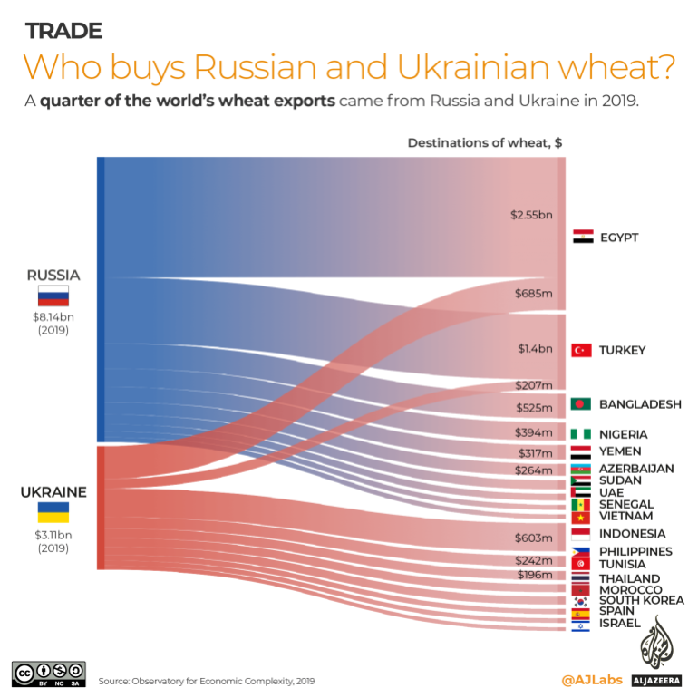
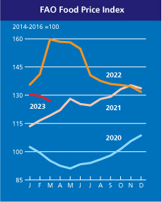
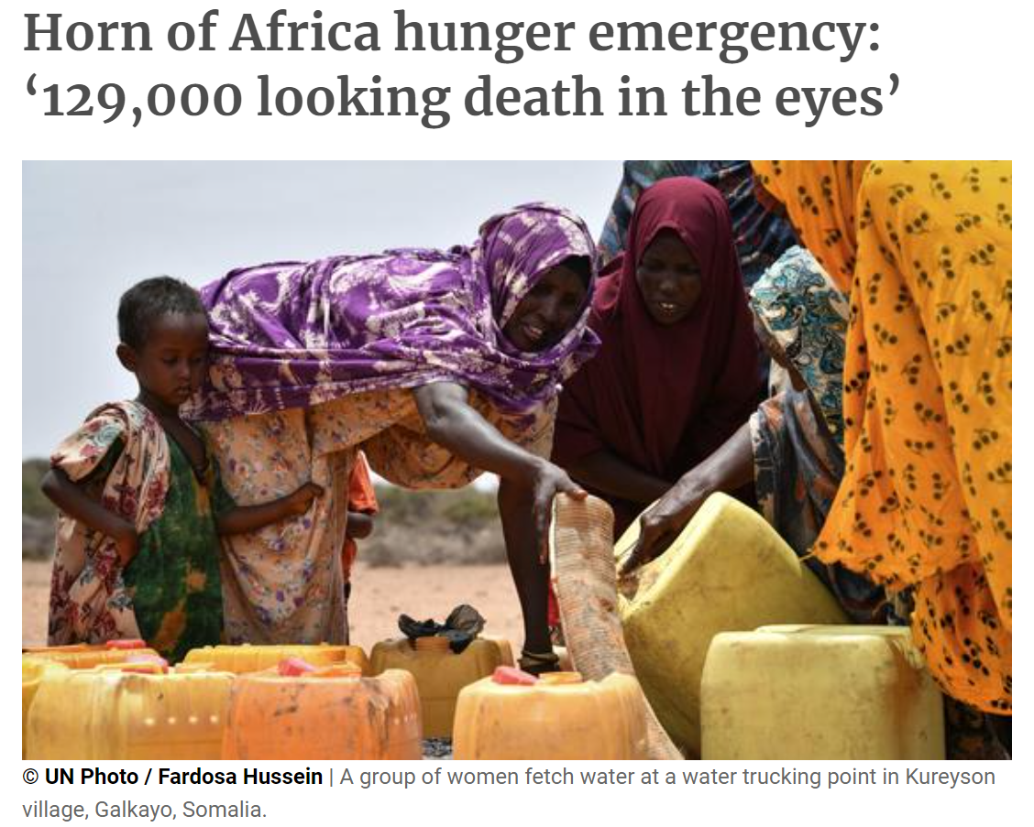
Africa: Food crisis exacerbated by the war
Vulnerable food supply
Imports in 2020: 15 African countries > 50%; six > 70%
African household consumption on food: 42%~60%
What happened and will happen?
COVID19 + Drought/Flooding
-> Low food reserve
+ Russia-Ukraine War 2022
-> Prices of food, fuel, and fertilizers ↑
+ Other factors (credit downgrade, civil conflicts, …)
-> The worst food crisis in the past 10 years

Slide 8
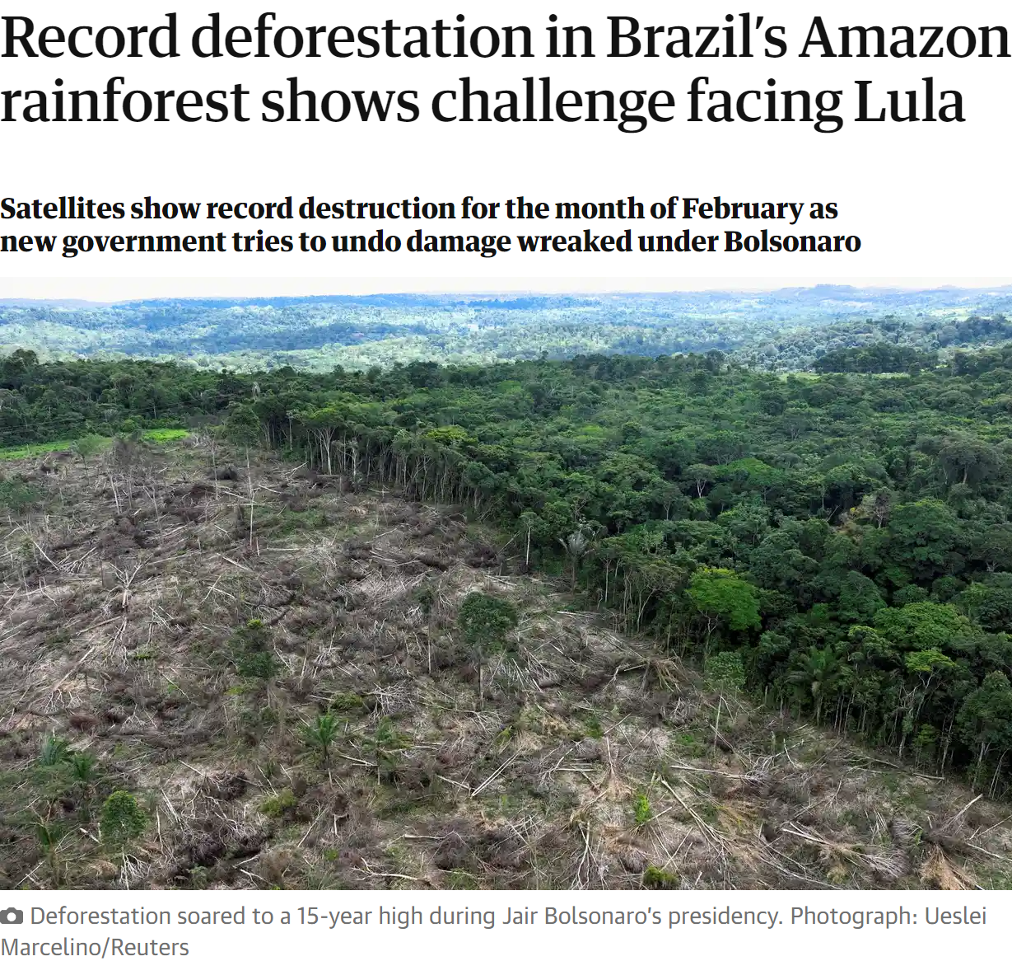
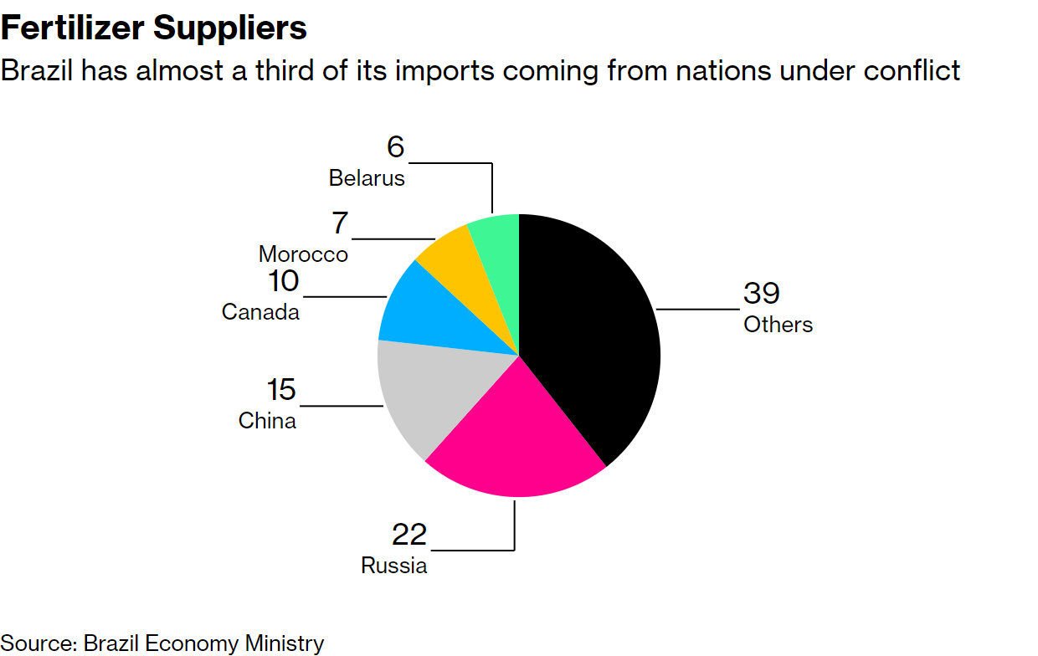
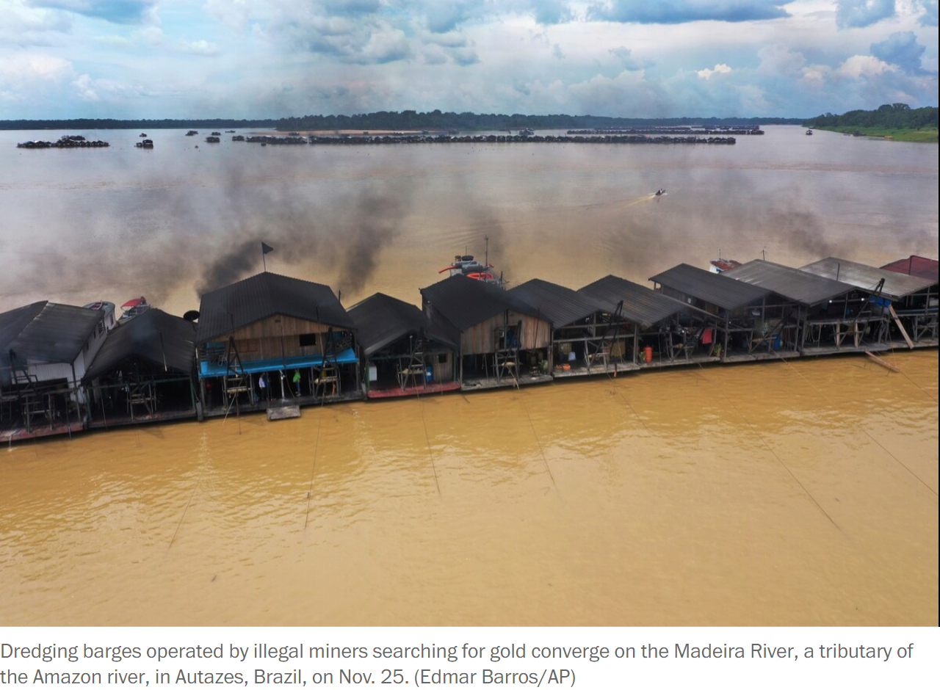
Brazil: War as an excuse for mining and deforestation
Large fertilizer imports from Russia and Belarus
+ Russia-Ukraine War 2022
-> Worries about shortage
-> Claim by the former president Bolsonaro: “Brazil can find the potassium it needs to produce its own fertilizers on Indigenous lands.”
Indigenous lands: safeguards against deforestation
-> The mining legislation was passed.
-> Deforestation soared to a 15-year high during the Bolsonaro years, as well as mining pollution.

Slide 9
The telecoupling impacts
War
Food crisis
Mining
& Deforestation

Slide 10
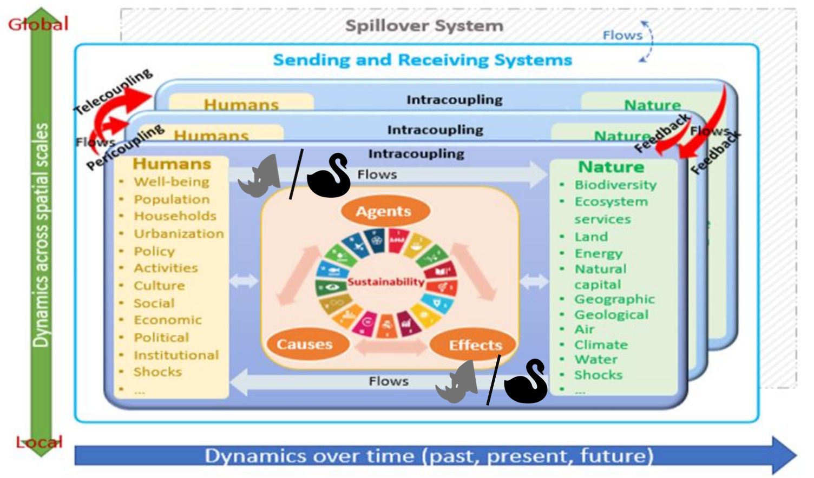
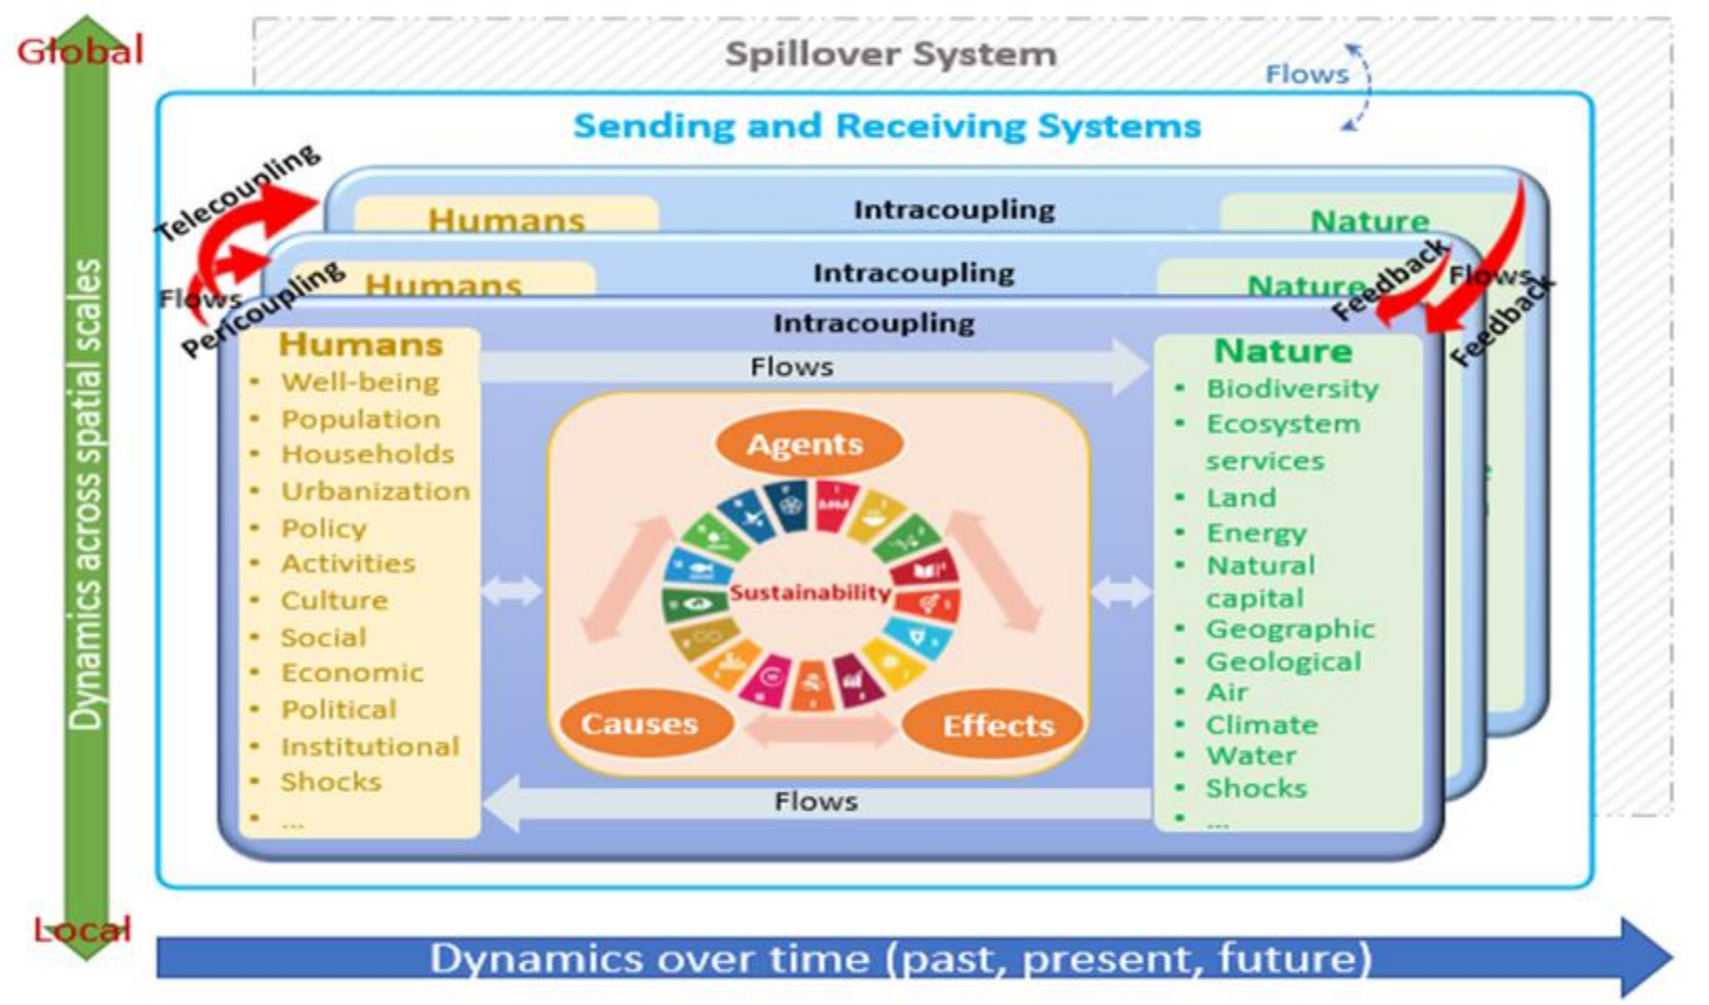
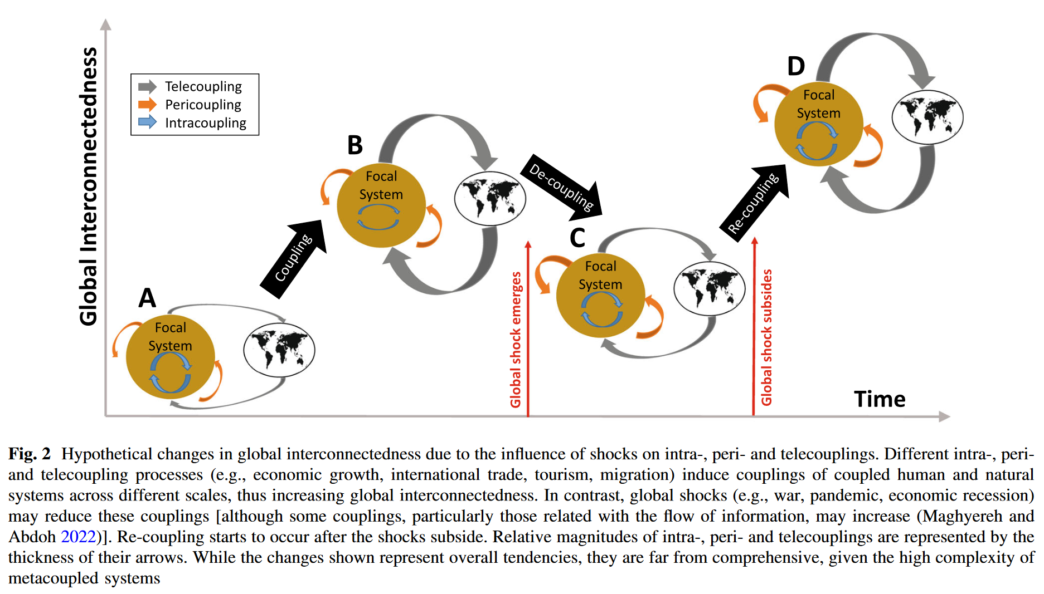
Discussion – Shocks in SES (Rhino & Swan)
Change of behaviors & flows.
Economic recession
Pandemic
War (nuclear)
Climate change
Giant comet
Tipping point of
ecosystem self-regulation

Slide 11
Conclusion
The Russia-Ukraine War 2022 has significant telecoupling impacts on Africa and Brazil, leading to the most severe food crisis and deforestation in the near decade.
Shocks like black-swan and grey-rhino events should be integrated in the SES frameworks to consider changes in behaviors and flows and to prepare us for the increasingly uncertain future.

