Slide 1
Social and environmental drivers of COVID-19 and its effects on social and environmental systems
Nicole Dear
Department of Geography, Environment, and Spatial Sciences
Michigan State University

Slide 2
Motivation
Total of 660.1 million confirmed cases and 6.7 million deaths worldwide due to COVID-19 to date
Effects of COVID-19 are unequally distributed across people and places
Human health and disease are located within social networks, and ecological, economic and political systems → suitable environments for exposure and transmission and influence how institutions respond
(McLafferty, 2010)

Slide 3
Objective
To characterize the direct and indirect, positive and negative, drivers of COVID-19 and its effects on social and environmental systems
  Social factors and human health (COVID-19 cases, deaths, mental health)
  Environmental factors (air pollution, energy use)
  Economic factors (income, employment, tourism)

Slide 4
December 2019 First identified in Wuhan, Hubei Province, China
January 2020 First cases outside of China (Thailand, Japan, Republic of Korea)
First case of COVID-19 in the US was confirmed
Spread of SARS-CoV-2 confirmed to be driven by person-to- person transmission → Wuhan placed under lockdown
March 11, 2020 WHO declared COVID-19 a pandemic, following reports of over 118,000 cases and 4,291 deaths in 114 countries
March 13, 2020 Trump Administration declared a national emergency

Slide 5
Origins and diffusion
Environmental: Most early cases linked to the Huanan Seafood Wholesale Market → potential cross-species transfer event
Social: Densely populated and interconnected areas at higher risk for transmission → contact and hierarchical diffusion
Economic: Local/global travel, bars and restaurants potentially also driving transmission

Slide 6
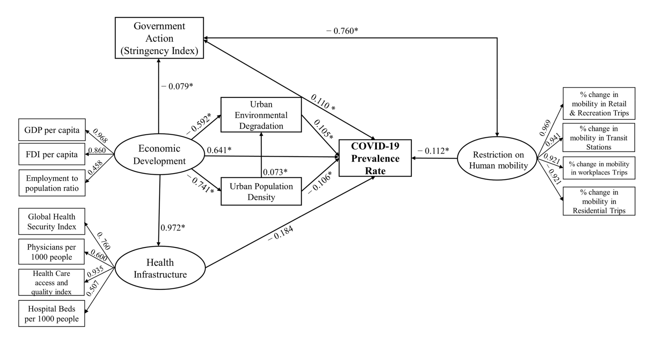
Early stage spread (Feb 2020 to May 2021)
(Fan, Chen and Sarker, 2022)
? Economic development → comorbid conditions, disparities
? High urban population density → more restrictions/lockdowns

Slide 7
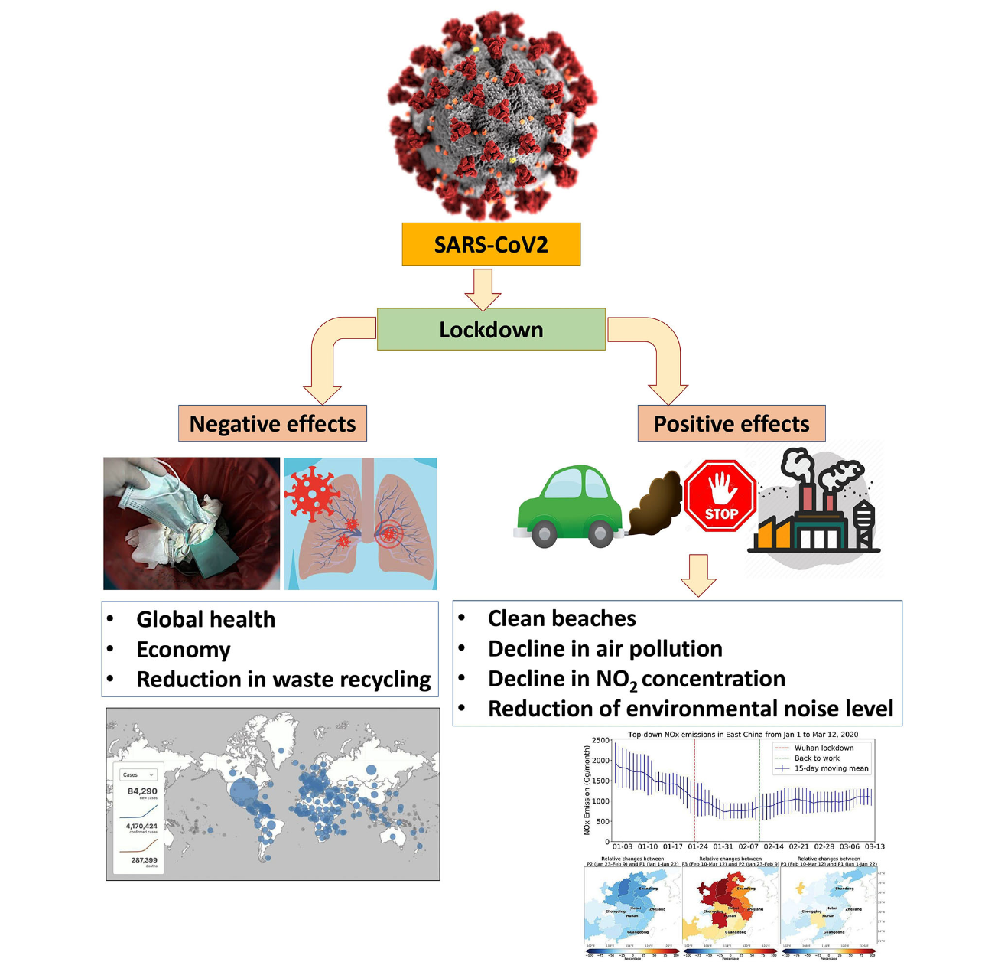
Positive and negative effects: simple conceptualization
(Kumar et al, 2020)

Slide 8
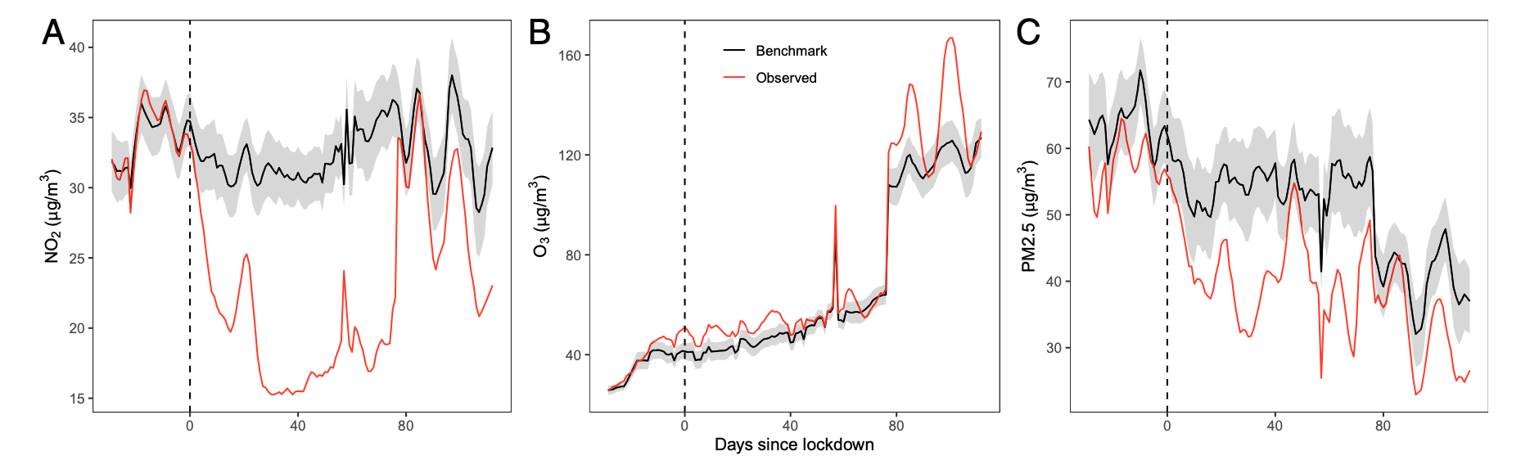
Across 34 countries, after accounting for meteorological variations, reductions in population-weighted concentration of nitrogen dioxide and particulate matter levels by 60% and 31% → largely due to reductions in transportation sector emissions
(Venter et al, 2020)

Slide 9
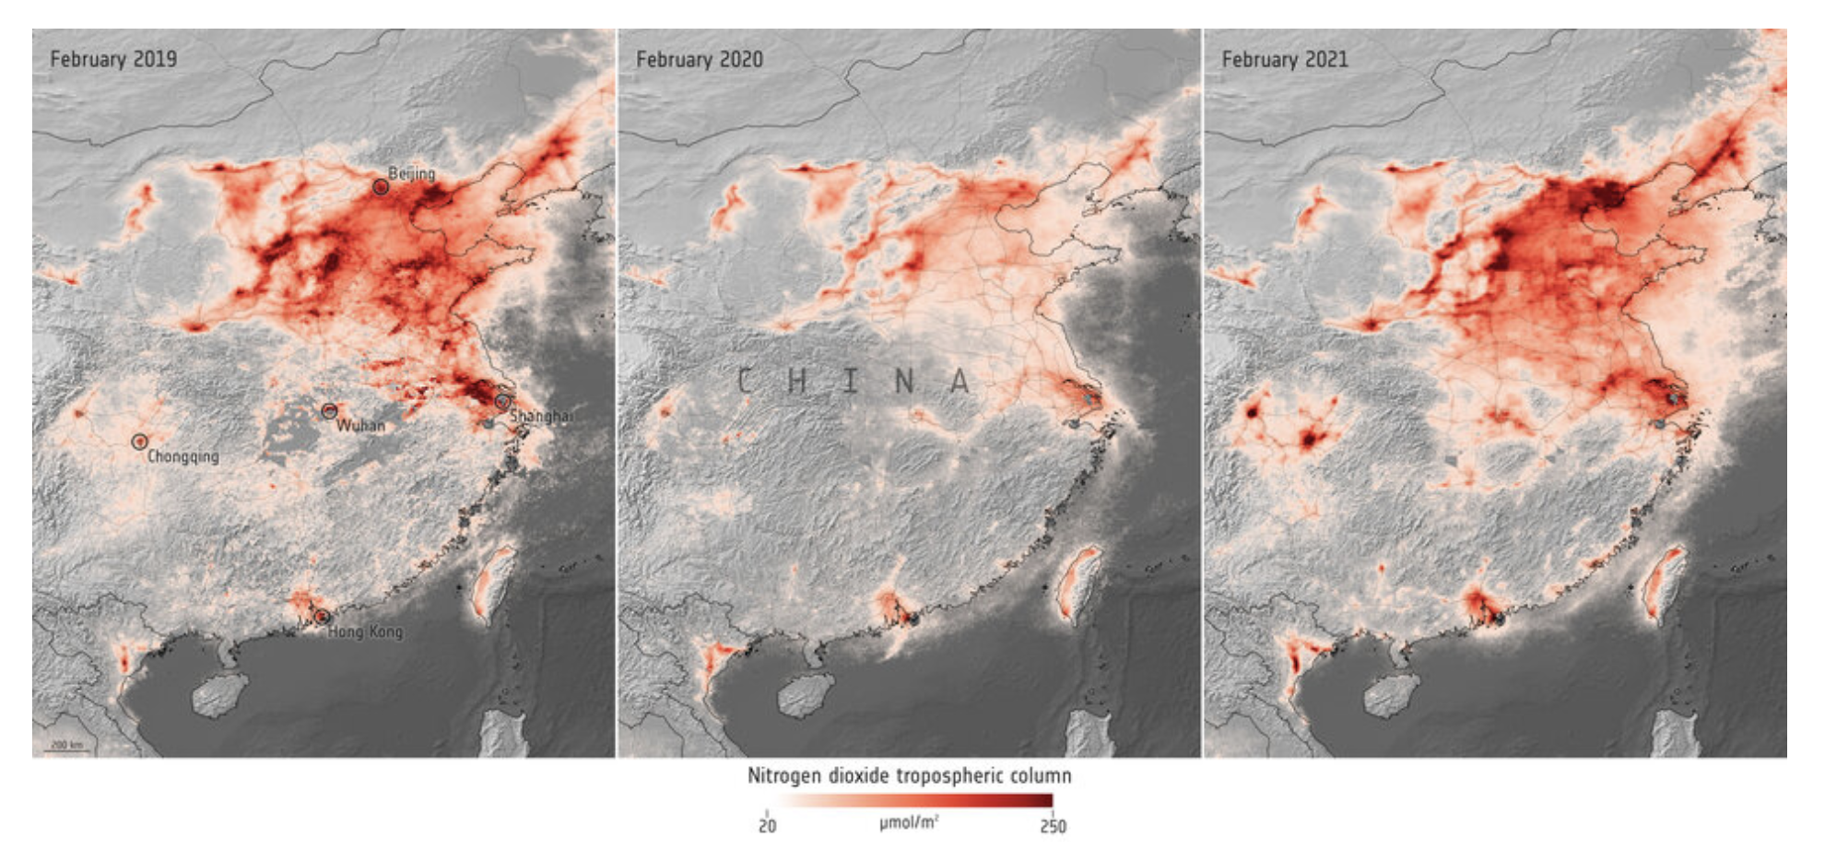
Even as early as February 2021, nitrogen dioxide levels began bouncing back to pre-COVID levels
(European Space Agency Blog)

Slide 10
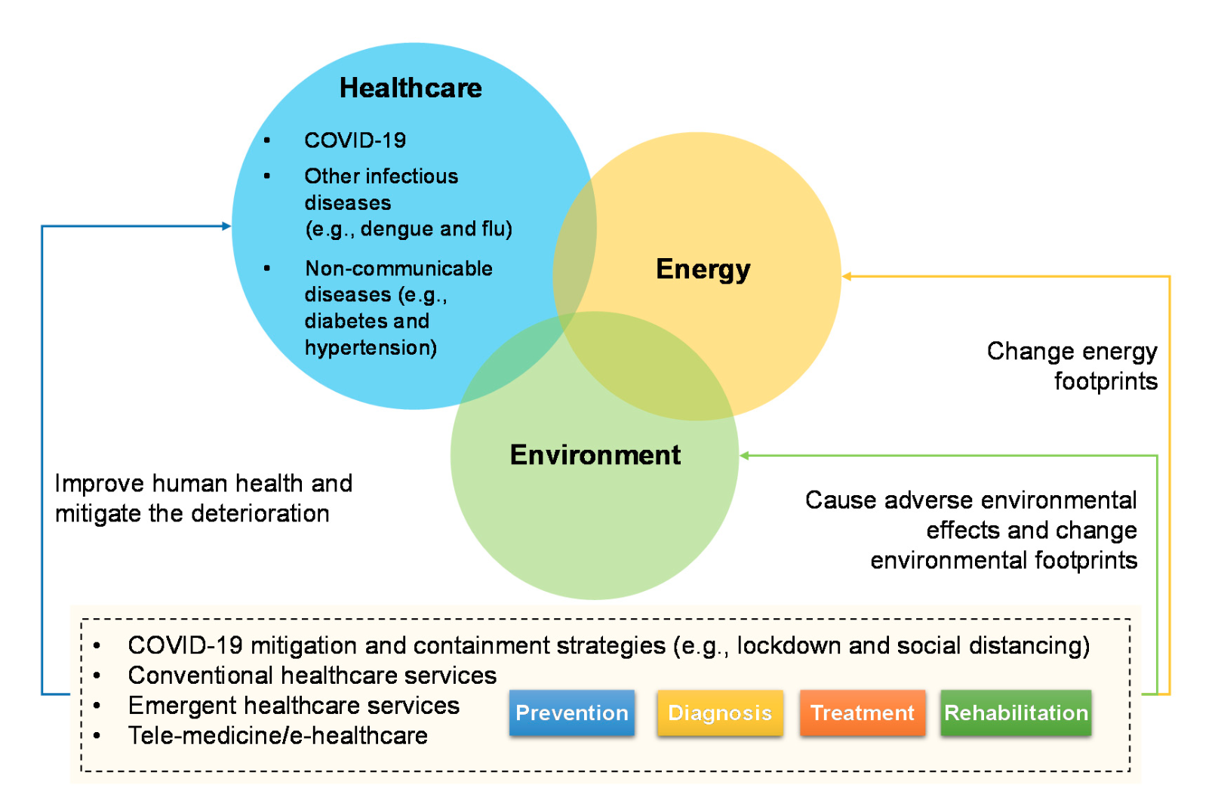
Healthcare–energy–environment system
(Jiang et al, 2021)

Slide 11
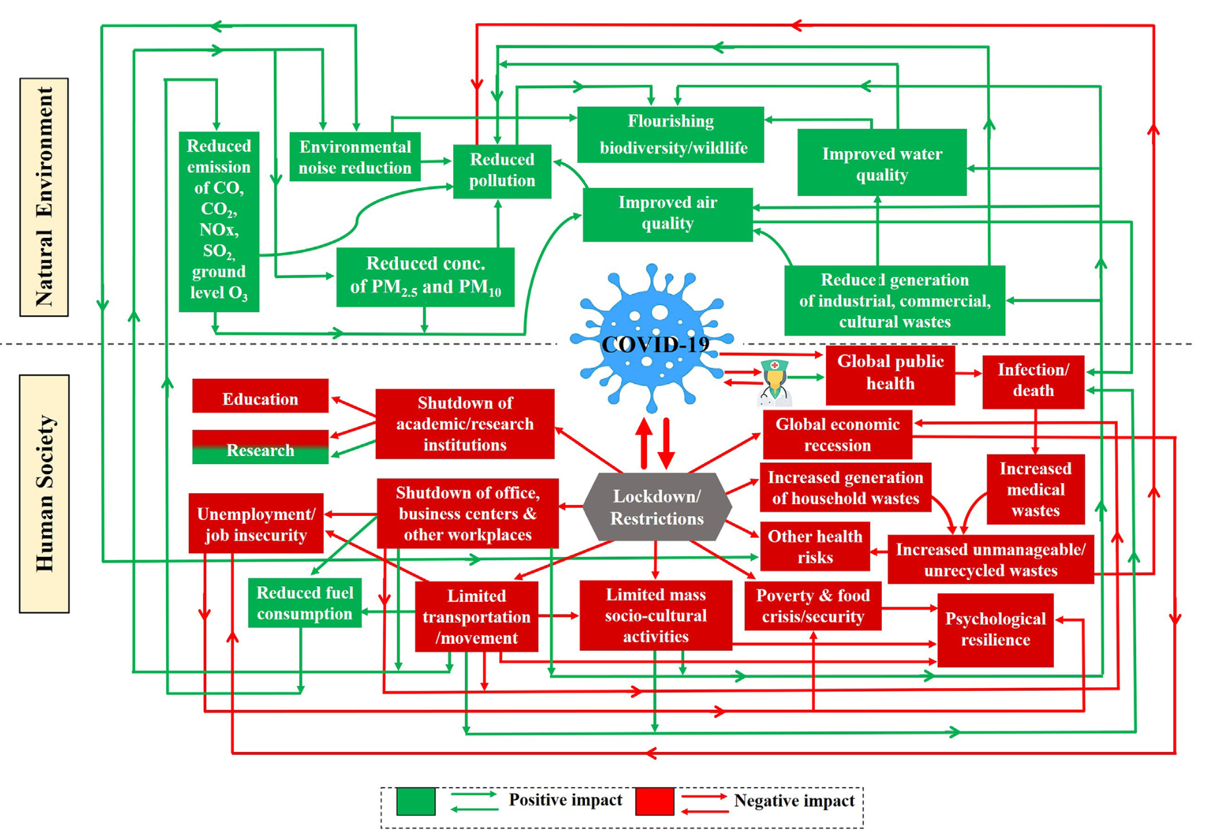
Mixed impacts of the COVID-19 pandemic and interventions on society and the environment
(Sarkar et al, 2021)

Slide 12
Consequences
Environmental: reduced driving/transportation, emergency logistics (supply chain), solid waste (PPE, test kits)
Social: morbidity and mortality, mental health, increase disparities (comorbid conditions and health care access), reduced healthcare seeking for other illnesses, telemedicine
Economic: Store/business closures, layoffs, people leaving workforce

Slide 13
Thank you!
Questions? Suggestions?

